Slide 1
6.852: Distributed Algorithms Fall, 2015
Lecture 22

Slide 2
Today’s plan
Asynchronous shared memory model vs. asynchronous network model
Consensus in asynchronous networks
The Paxos consensus protocol
Reading:
Chapter 17
[Lamport] The Part-Time Parliament (The Paxos paper)
Next time:
Failure detectors
Reading:
[Chandra, Toueg] Unreliable FDs for reliable distributed systems
[Cornejo, Lynch, Sastry] Asynchronous FDs
[Pike, Song, Sastry] FDs for Dining Philosophers
[Sastry, Pike, Welch] Weakest FD for Wait-Free Dining Philosophers
[Chandra, Hadzilacos, Toueg] Weakest FD for Consensus
[Lynch, Sastry] Weakest Asynchronous FD for Consensus

Slide 3
Shared memory vs. networks
Simulating shared memory in distributed networks:
A popular method for simplifying distributed programming.
Distributed Shared Memory (DSM).
Easy if there are no failures.
Possible if n > 2f; impossible if n ≤ 2f.
[Attiya, Bar-Noy, Dolev] fault-tolerant algorithm.
Simulating networks using shared memory:
Easier, because shared memory is “more powerful”.
Works for any number of processes and failures.
Useful mainly for lower bounds, impossibility results.
Carry over impossibility results for the shared memory model to the network model
E.g., for fault-tolerant consensus.

Slide 4
Paxos Consensus Algorithm [Lamport]
A fault-tolerant consensus algorithm for distributed networks.
Can use it to implement a fault-tolerant replicated state machine (RSM), to produce the appearance of centralized shared memory, for any data types, in a distributed network.
Generalizes Lamport’s timestamp-based non-fault-tolerant RSM results.
Consensus algorithm uses ideas from [Dwork, Lynch, Stockmeyer 88].

Slide 5
Simulating networks using shared-memory systems
p₁
C_{1,2}
p₂
A
p₁
C_{2,1}
x₁
p₂
x₂
p_{n}

Slide 6
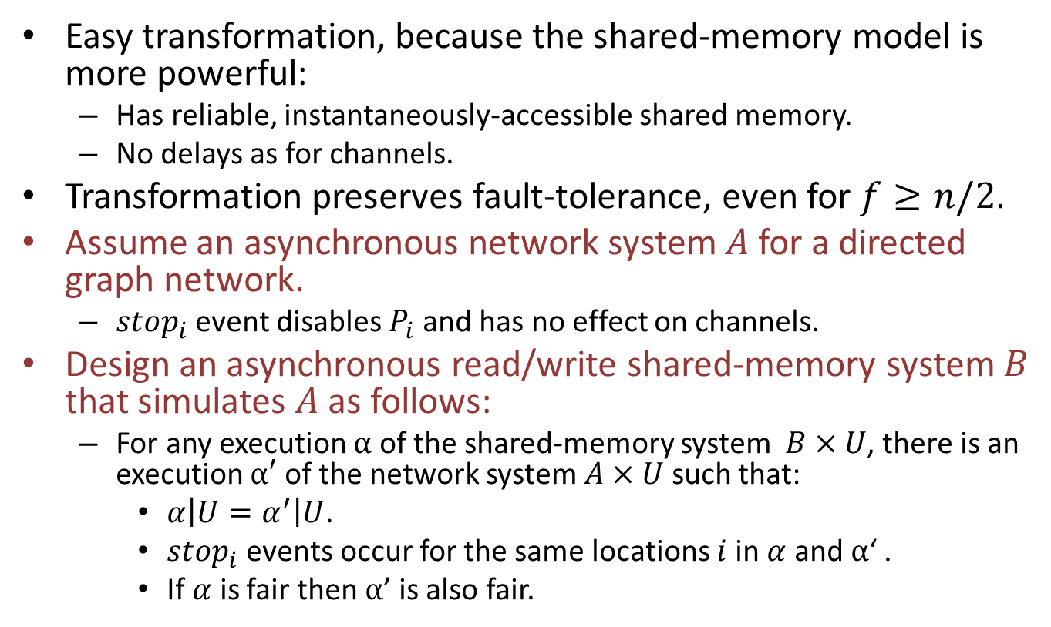
Simulating networks using shared-memory systems
Easy transformation, because the shared-memory model is more powerful:
Has reliable, instantaneously-accessible shared memory.
No delays as for channels.
Transformation preserves fault-tolerance, even for $f≥n/2$.
Assume an asynchronous network system $A$ for a directed graph network.
$stop_{i}$event disables $P_{i}$and has no effect on channels.
Design an asynchronous read/write shared-memory system $B$ that simulates $A$ as follows:
For any execution $α$ of the shared-memory system $B×U$, there is an execution $α′$ of the network system $A×U$ such that:
$α\left|U=α^{′}\right|U$.
$stop_{i}$ events occur for the same locations $i$in $α$ and $α$‘ .
If $α$ is fair then $α$’ is also fair.
Notes:
The simulation notion is like what we had for atomic objects.
Fairness carries over: fair here means that the non-failed processes keep getting chances to take steps (and in B, the channels keep delivering messages).

Slide 7
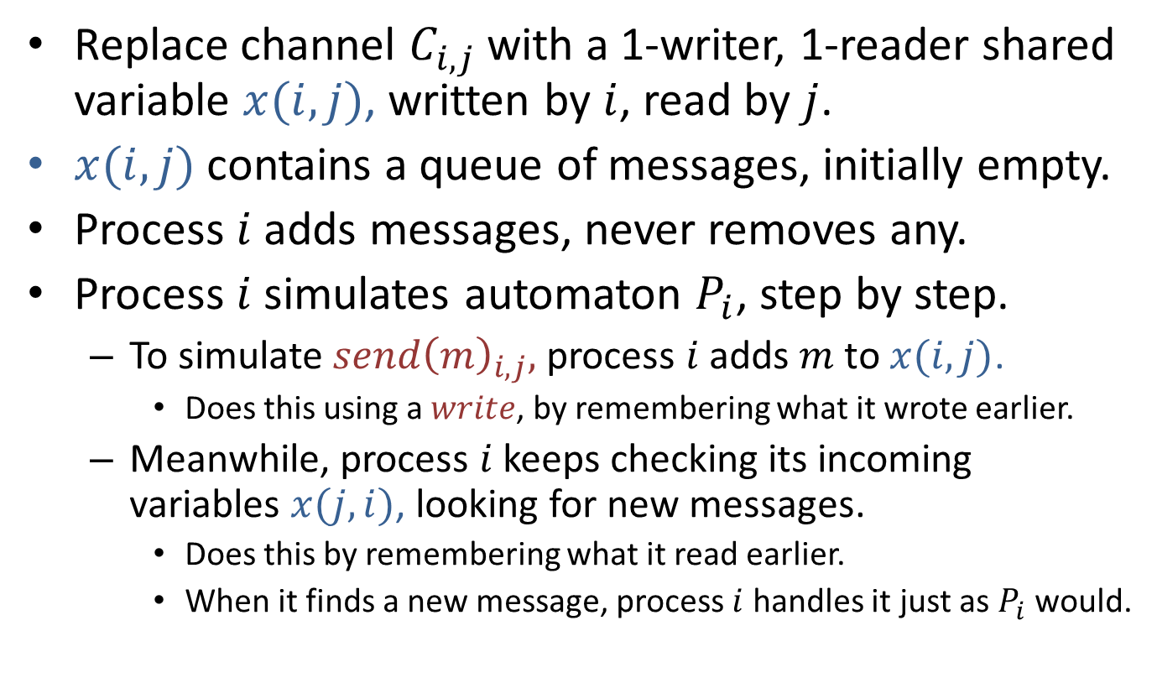
An easy algorithm
Replace channel $C_{i,j}$with a 1-writer, 1-reader shared variable $x(i,j)$, written by $i$, read by $j$.
$x(i,j)$ contains a queue of messages, initially empty.
Process $i$ adds messages, never removes any.
Process $i$ simulates automaton $P_{i}$, step by step.
To simulate $send{\left(m\right)}_{i,j},$process $i$ adds $m$ to $x(i,j)$.
Does this using a $write$, by remembering what it wrote earlier.
Meanwhile, process $i$ keeps checking its incoming variables $x(j,i)$, looking for new messages.
Does this by remembering what it read earlier.
When it finds a new message, process $i$ handles it just as $P_{i}$would.

Slide 8
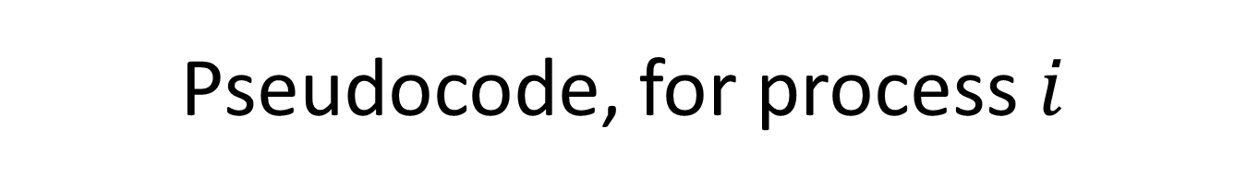
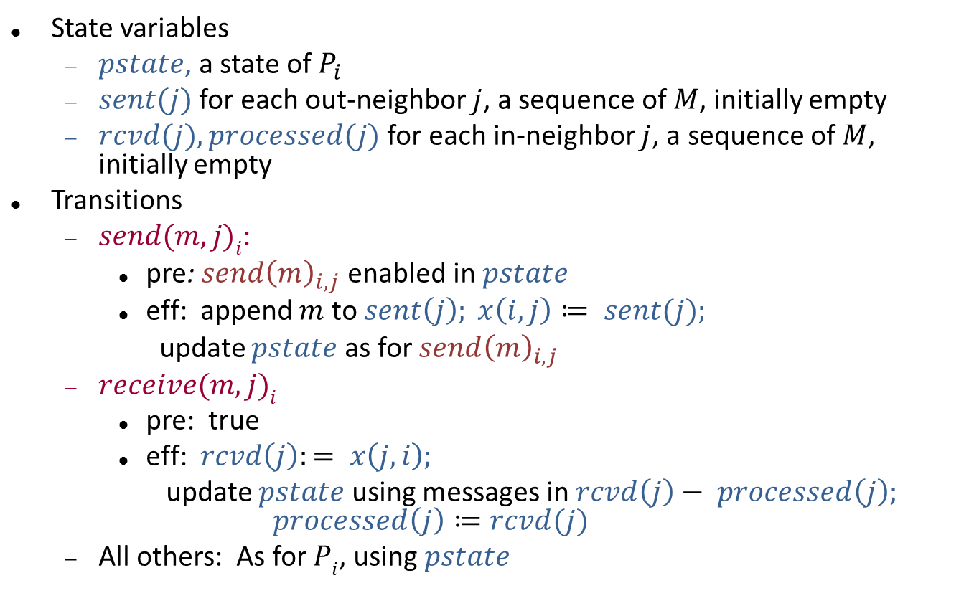
Pseudocode, for process $i$
State variables
$pstate$, a state of $P_{i}$
$sent(j)$ for each out-neighbor $j$, a sequence of $M$, initially empty
$rcvd(j), processed(j)$for each in-neighbor $j$, a sequence of $M$, initially empty
Transitions
$send(m,j)i$:
pre: $send{\left(m\right)}_{i,j}$enabled in $pstate$
eff: append $m$ to $sent\left(j\right); x\left(i,j\right)≔ sent(j);$
update $pstate$ as for $send{\left(m\right)}_{i,j}$
$receive(m,j)i$
pre: true
eff: $rcvd\left(j\right):= x\left(j,i\right);$
update $pstate$ using messages in $rcvd\left(j\right)− processed\left(j\right);$
$$processed\left(j\right)≔rcvd(j)$$
All others: As for $Pi$, using $pstate$
Notes:
Send and receive are internal actions, for the shared-memory system.

Slide 9
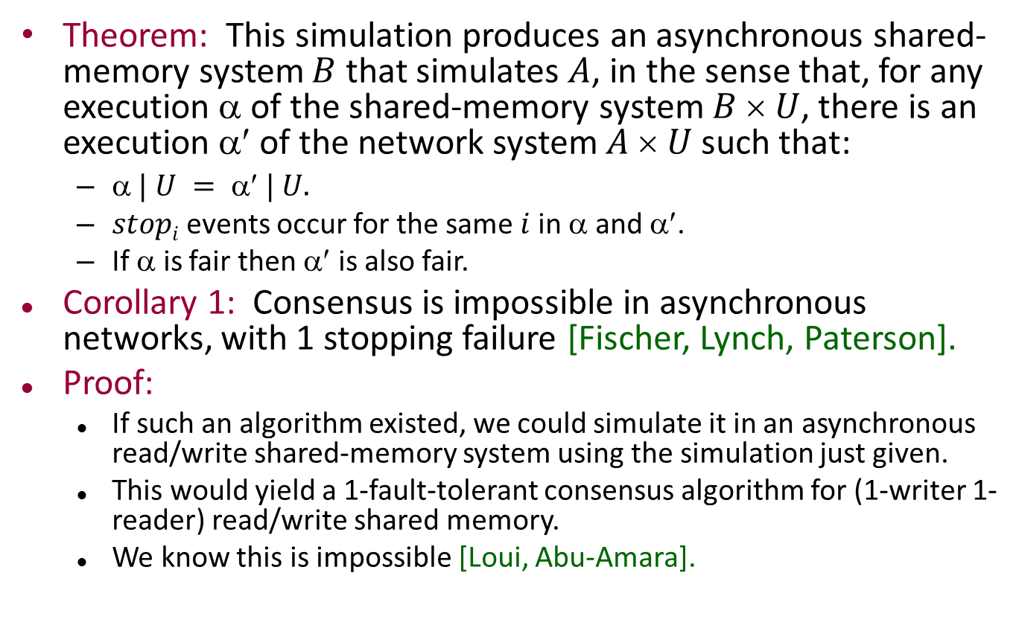
Theorem and Corollary 1
Theorem: This simulation produces an asynchronous shared-memory system $B$ that simulates $A$, in the sense that, for any execution $$ of the shared-memory system $B  U$, there is an execution $$ of the network system $A  U$such that:
$ | U =  | U.$
$stopi$events occur for the same $i$in $$ and $$.
If $$ is fair then $$ is also fair.
Corollary 1: Consensus is impossible in asynchronous networks, with 1 stopping failure [Fischer, Lynch, Paterson].
Proof:
If such an algorithm existed, we could simulate it in an asynchronous read/write shared-memory system using the simulation just given.
This would yield a 1-fault-tolerant consensus algorithm for (1-writer 1-reader) read/write shared memory.
We know this is impossible [Loui, Abu-Amara].
Notes:
Although here I am proving FLP from LA, historically FLP came first.

Slide 10
Corollary 2
Corollary 2: Consensus is impossible in asynchronous broadcast systems, with 1 stopping failure [Fischer, Lynch, Paterson].
Asynchronous broadcast system: A process can put a message in all its outgoing channels in one step, and all are guaranteed to eventually be delivered.
That is, a process cannot fail in the middle of a broadcast.
Proof:
If such an algorithm existed, we could simulate it in an asynchronous shared-memory system using a simple extension of the simulation above.
Extension uses 1-writer multi-reader shared variables to represent the broadcast channels.
This would yield a 1-fault-tolerant consensus algorithm for 1-writer multi-reader read/write shared memory.
We already know this is impossible [Loui, Abu-Amara].
Q: Is this counterintuitive?
Notes:
We considered failure in the middle of a broadcast when we studied this problem in synchronous networks. It was important to the proof there.
It may seem counterintuitive…

Slide 11
Is this counterintuitive?
Corollary 2: Consensus is impossible in asynchronous broadcast systems, with 1 stopping failure [Fischer, Lynch, Paterson].
Asynchronous broadcast system: Process can put a message in all its outgoing channels in one step, and all are guaranteed to eventually be delivered.
Recall that in the synchronous model, impossibility results for consensus depended on processes failing in the middle of a broadcast.
Now every broadcast is completed, and guaranteed to be delivered everywhere.
But we still get impossibility, this time because of asynchrony.

Slide 12
Simulating shared-memory systems using networks
A
p₁
p₁
C_{1,2}
p₂
x₁
p₂
C_{2,1}
x₂
p_{n}
Notes:
Now the more interesting direction.

Slide 13
Simulating shared memory in distributed networks
Can be used to simplify distributed programming.
Non-fault-tolerant algorithms:
Single-copy
Multi-copy
Majority voting
Fault-tolerant algorithms:
[Attiya, Bar-Noy, Dolev] algorithm for n > 2f.
Impossibility result for n ≤ 2f.
Notes:
This direction is harder, because the channels are “weaker” than instantaneously-shared shared variables.

Slide 14
Non-fault-tolerant simulation of shared memory in distributed networks
p₁
A
p₁
C_{1,2}
p₂
x₁
C_{2,1}
p₂
x₂
p_{n}

Slide 15
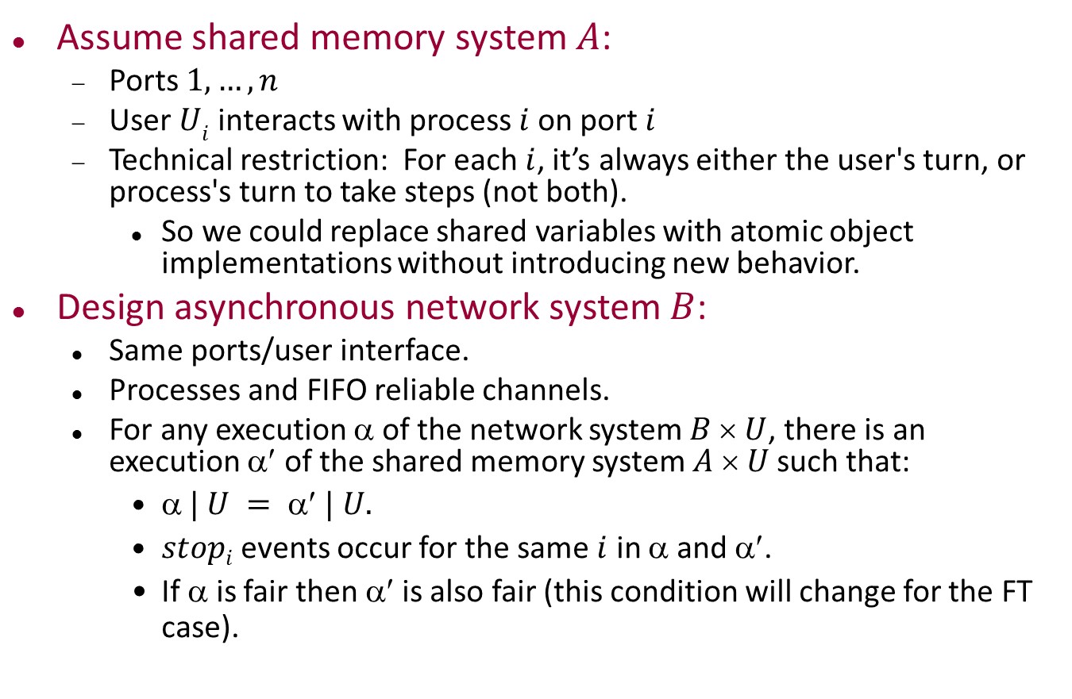
Simulating shared memory in networks
Assume shared memory system $A$:
Ports $1,…,n$
User $Ui$ interacts with process $i$on port $i$
Technical restriction: For each $i$, it’s always either the user's turn, or process's turn to take steps (not both).
So we could replace shared variables with atomic object implementations without introducing new behavior.
Design asynchronous network system $B$:
Same ports/user interface.
Processes and FIFO reliable channels.
For any execution $$ of the network system $B  U$, there is an execution $$ of the shared memory system $A  U$such that:
$ | U =  | U.$
$stopi$events occur for the same $i$ in $$ and $$.
If $$ is fair then $$is also fair (this condition will change for the FT case).

Slide 16
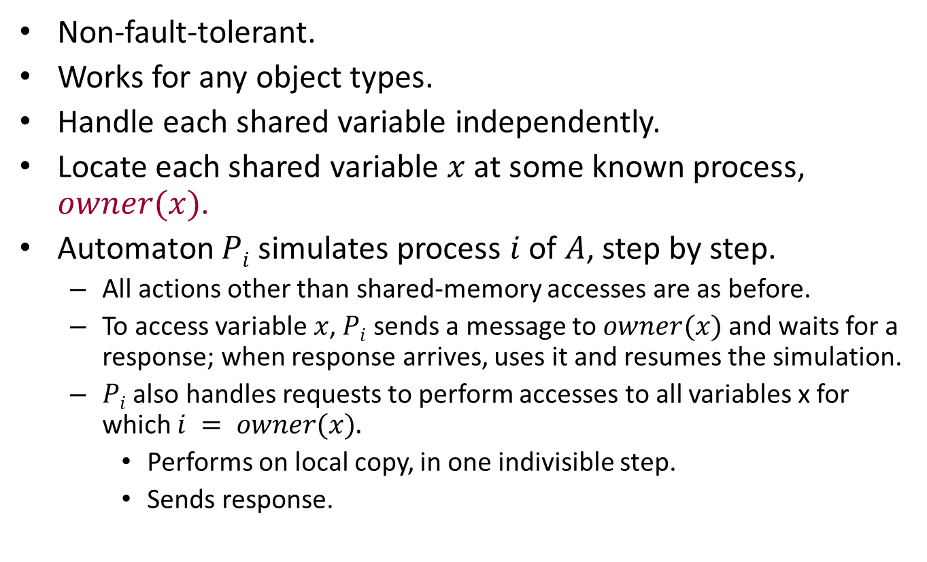
Single-copy simulation
Non-fault-tolerant.
Works for any object types.
Handle each shared variable independently.
Locate each shared variable $x$ at some known process, $owner(x)$.
Automaton $Pi$ simulates process $i$of $A$, step by step.
All actions other than shared-memory accesses are as before.
To access variable $x$, $Pi$ sends a message to $owner(x)$and waits for a response; when response arrives, uses it and resumes the simulation.
$Pi$ also handles requests to perform accesses to all variables x for which $i = owner(x).$
Performs on local copy, in one indivisible step.
Sends response.

Slide 17
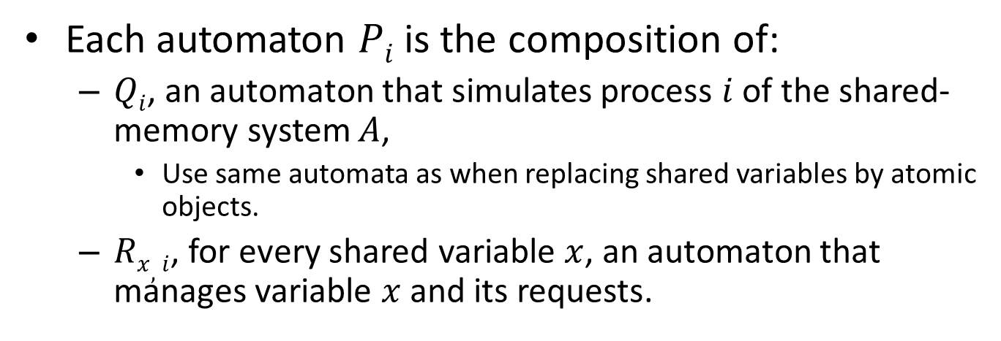
Formally…
Each automaton $Pi$is the composition of:
$Qi$, an automaton that simulates process $i$ of the shared-memory system $A$,
Use same automata as when replacing shared variables by atomic objects.
$Rx,i$, for every shared variable $x$, an automaton that manages variable $x$ and its requests.
P₁
P₂
P_{n}
Q₁
Q₂
Q_{n}
R_{x,1}
R_{y,1}
R_{x,2}
R_{y,2}
R_{x,n}
R_{y,n}

Slide 18
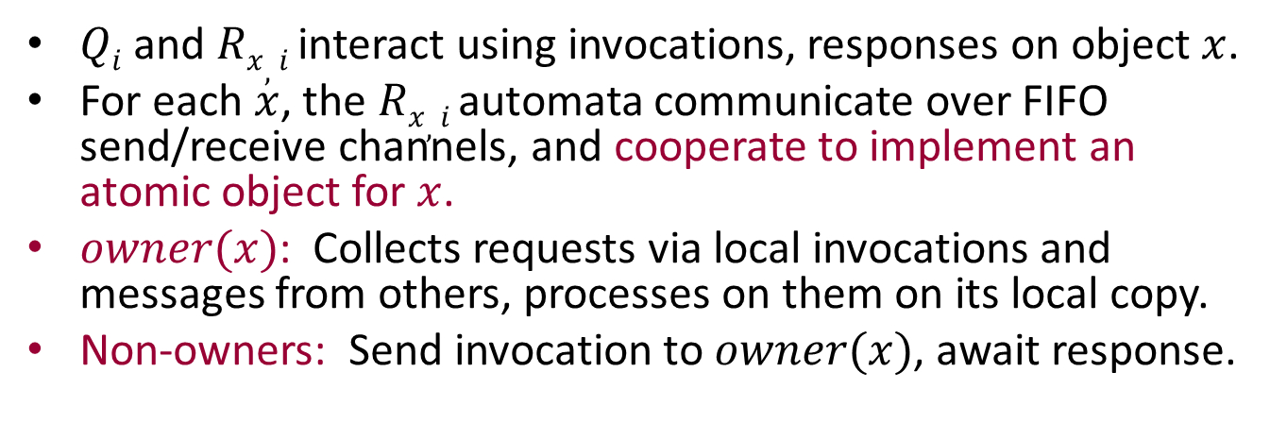
Formally…
$Qi$and $Rx,i$interact using invocations, responses on object $x$.
For each $x$, the $Rx,i$ automata communicate over FIFO send/receive channels, and cooperate to implement an atomic object for $x$.
$owner(x)$: Collects requests via local invocations and messages from others, processes on them on its local copy.
Non-owners: Send invocation to $owner(x)$, await response.
P₁
P₂
P_{n}
Q₁
Q₂
Q_{n}
R_{x,1}
R_{y,1}
R_{x,2}
R_{y,2}
R_{x,n}
R_{y,n}

Slide 19
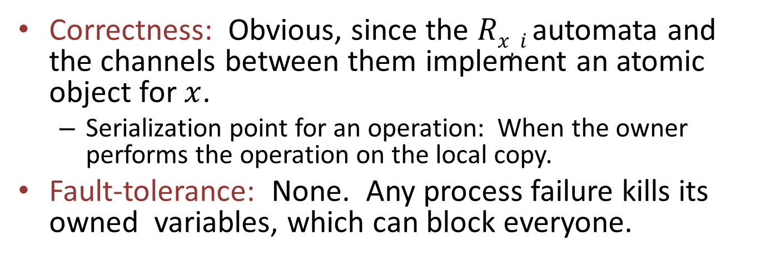
Formally…
Correctness: Obvious, since the $Rx,i$ automata and the channels between them implement an atomic object for $x$.
Serialization point for an operation: When the owner performs the operation on the local copy.
Fault-tolerance: None. Any process failure kills its owned variables, which can block everyone.
P₁
P₂
P_{n}
Q₁
Q₂
Q_{n}
R_{x,1}
R_{y,1}
R_{x,2}
R_{y,2}
R_{x,n}
R_{y,n}

Slide 20
Remarks
Optimization: Avoid busy-waiting on a remote shared variable: Send one request, let owner notify sender when the value of the variable changes.
Q: Where are the best locations for the copies?
P₁
P₂
P_{n}
Q₁
Q₂
Q_{n}
R_{x,1}
R_{y,1}
R_{x,2}
R_{y,2}
R_{x,n}
R_{y,n}
Notes:
Sometimes shared-memory algorithms are written using “busy-waiting”, where a process reads a variable repeatedly until some condition is true.
In a network emulation of shared memory, that would cost many messages.
We might avoid most of this by letting the owner notify the sender when the variable value changes, or when some condition becomes true on the variable.

Slide 21
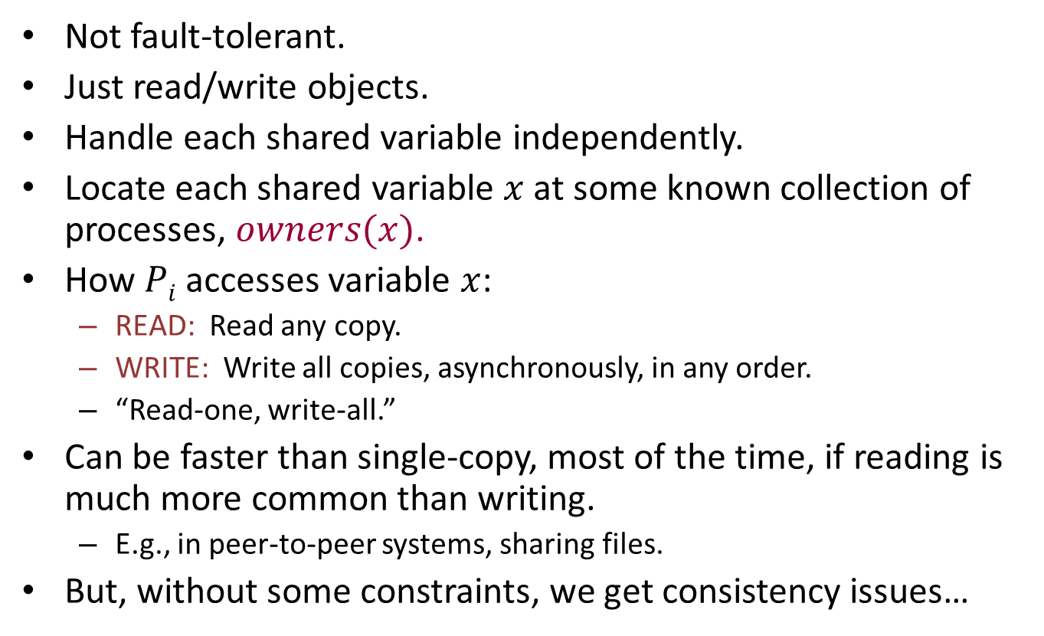
Multi-copy simulation
Not fault-tolerant.
Just read/write objects.
Handle each shared variable independently.
Locate each shared variable $x$ at some known collection of processes, $owners(x)$.
How $Pi$ accesses variable $x$:
READ: Read any copy.
WRITE: Write all copies, asynchronously, in any order.
“Read-one, write-all.”
Can be faster than single-copy, most of the time, if reading is much more common than writing.
E.g., in peer-to-peer systems, sharing files.
But, without some constraints, we get consistency issues…

Slide 22
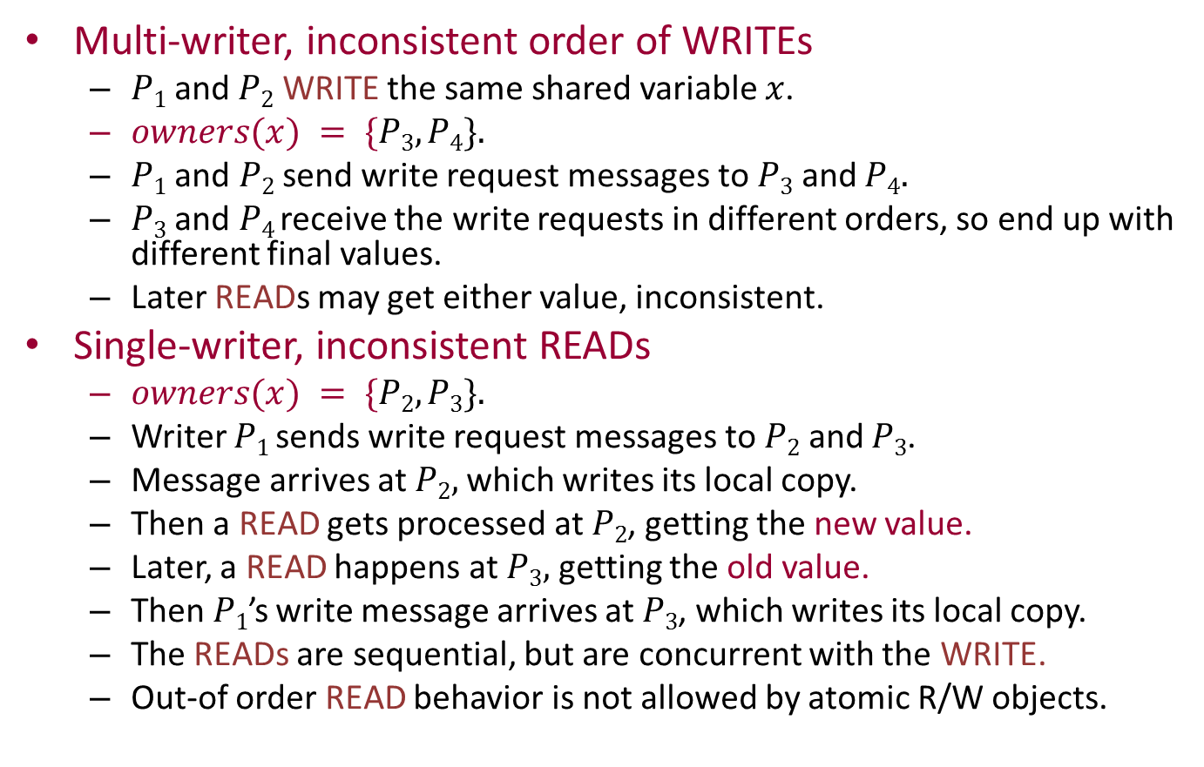
Bad examples
Multi-writer, inconsistent order of WRITEs
$P1$and $P2$ WRITE the same shared variable $x$.
$owners(x) = \{P3, P4\}.$
$P1$ and $P2$ send write request messages to $P3$ and $P4.$
$P3$ and $P4$ receive the write requests in different orders, so end up with different final values.
Later READs may get either value, inconsistent.
Single-writer, inconsistent READs
$owners(x) = \{P2, P3\}.$
Writer $P1$ sends write request messages to $P2$ and $P3$.
Message arrives at $P2,$which writes its local copy.
Then a READ gets processed at $P2$, getting the new value.
Later, a READ happens at $P3,$ getting the old value.
Then $P1$’s write message arrives at $P3$, which writes its local copy.
The READs are sequential, but are concurrent with the WRITE.
Out-of order READ behavior is not allowed by atomic R/W objects.
Notes:
For the first example, it seems that we would need some kind of version numbers to keep track of which version was later.
To say that these READs are concurrent with the WRITE, the implication is that the WRITE doesn’t terminate until it gets an ack for the writes.

Slide 23
Multi-copy simulation
So we need some more clever protocols…
Idea: Use atomic transactions:
E.g., to do a WRITE, perform all the writes to all copies as a single atomic transaction, so that they appear to occur instantaneously, as far as READ operations can tell.
Can implement such a transaction using 2-phase locking:
Phase 1: Lock all copies and write them.
Phase 2: Release all the locks.
Must solve deadlock problems for lock acquisition.
Works because serialization point for WRITE can be placed at a “lock point”, when all the locks are held.
Notes:
Transactions also have serialization points, where the entire transaction is assumed to take place.
But avoiding deadlocks in lock acquisition is another story, which we don’t have time for here.

Slide 24
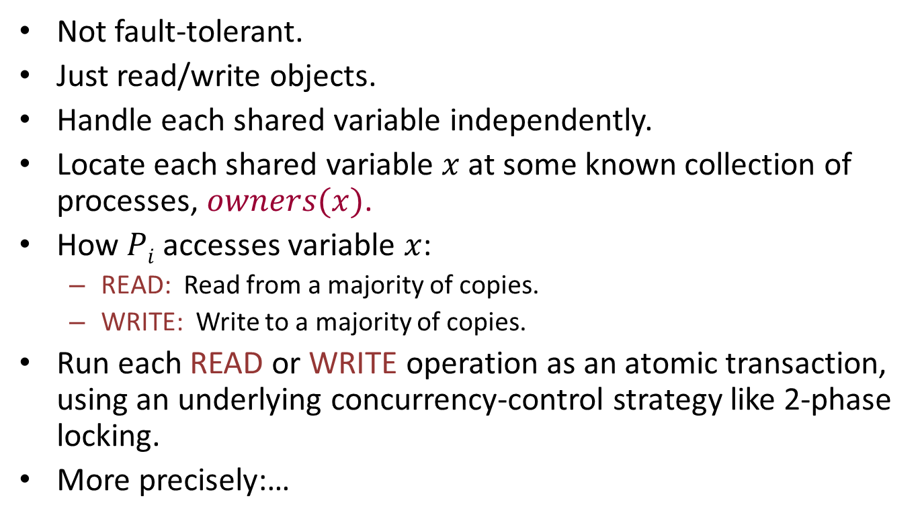
Majority-voting algorithms
Not fault-tolerant.
Just read/write objects.
Handle each shared variable independently.
Locate each shared variable $x$ at some known collection of processes, $owners(x)$.
How $Pi$ accesses variable $x$:
READ: Read from a majority of copies.
WRITE: Write to a majority of copies.
Run each READ or WRITE operation as an atomic transaction, using an underlying concurrency-control strategy like 2-phase locking.
More precisely:…

Slide 25
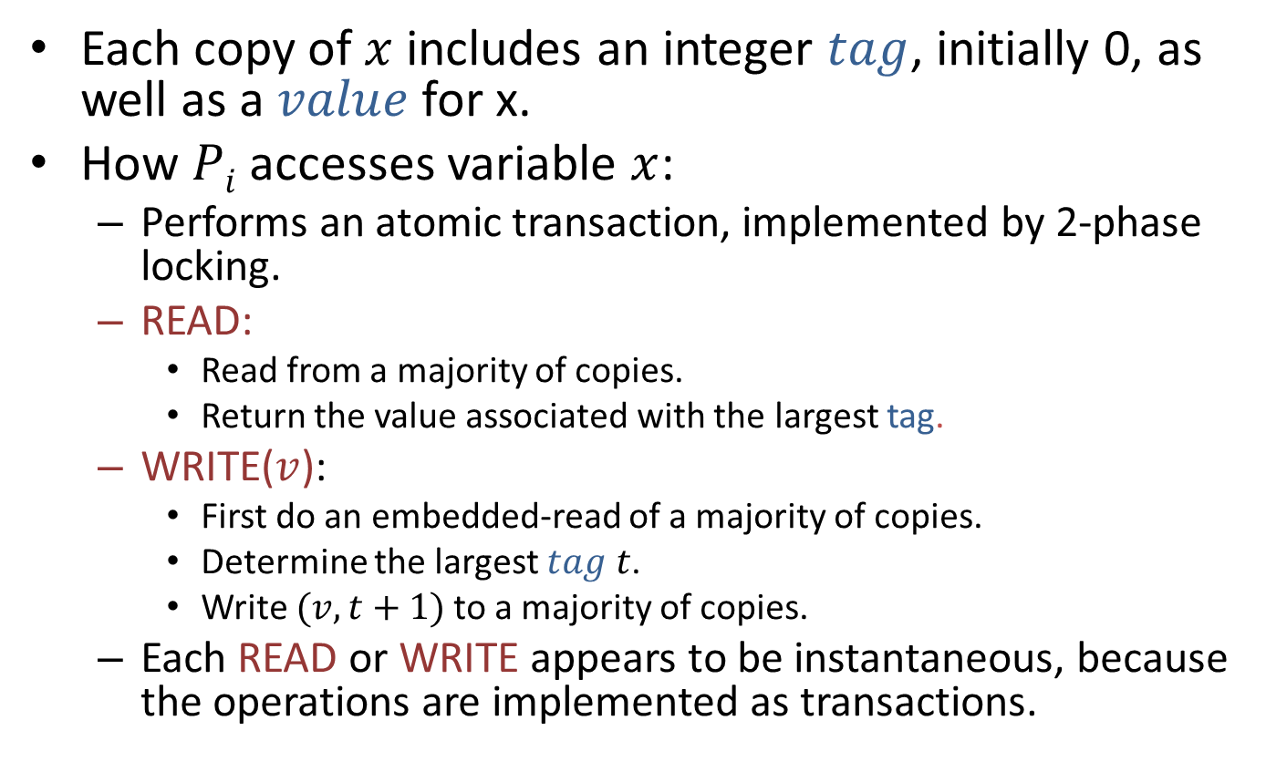
Majority-voting algorithms
Each copy of $x$ includes an integer $tag$, initially 0, as well as a $value$for x.
How $Pi$accesses variable $x$:
Performs an atomic transaction, implemented by 2-phase locking.
READ:
Read from a majority of copies.
Return the value associated with the largest tag.
WRITE($v$):
First do an embedded-read of a majority of copies.
Determine the largest $tag$ $t$.
Write $(v,t+1)$to a majority of copies.
Each READ or WRITE appears to be instantaneous, because the operations are implemented as transactions.
Notes:
No propagate phase here, unlike Vitanyi-Awerbuch.
That’s because there is no fine-grained interleaving here among the individual steps executed by the READs and WRITEs. These operations are executed as transactions.

Slide 26
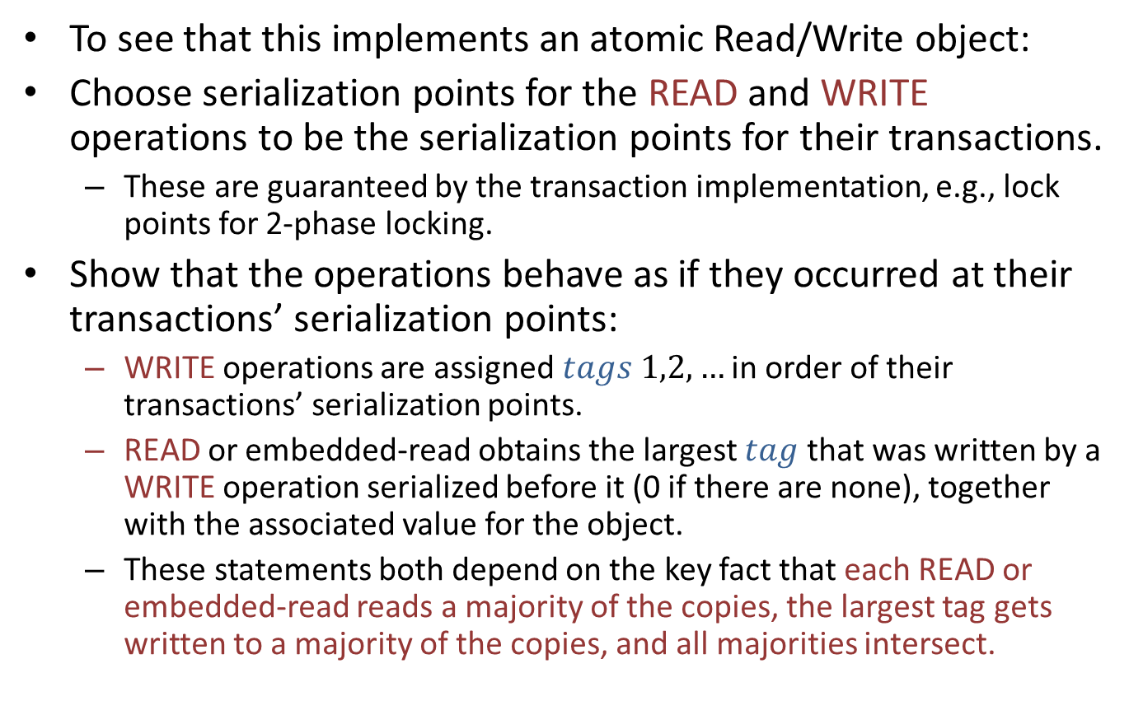
Why does this work?
To see that this implements an atomic Read/Write object:
Choose serialization points for the READ and WRITE operations to be the serialization points for their transactions.
These are guaranteed by the transaction implementation, e.g., lock points for 2-phase locking.
Show that the operations behave as if they occurred at their transactions’ serialization points:
WRITE operations are assigned $tags$ $1,2,…$ in order of their transactions’ serialization points.
READ or embedded-read obtains the largest $tag$ that was written by a WRITE operation serialized before it (0 if there are none), together with the associated value for the object.
These statements both depend on the key fact that each READ or embedded-read reads a majority of the copies, the largest tag gets written to a majority of the copies, and all majorities intersect.

Slide 27
Remarks
This is still not fault-tolerant:
Because standard transaction implementations like 2-phase locking aren’t fault-tolerant.
A process that fails while holding locks “kills” the locked objects.
Can generalize majorities to quorum configurations.
Quorum configuration:
A set of read-quorums, finite subsets of process indices,
A set of write-quorums, finite subsets of process indices, such that
R ∩ W ≠ ∅ for every read-quorum R and write-quorum W.
READ operation accesses any read-quorum.
WRITE operation accesses both a read-quorum and a write-quorum (in its two phases).
Allows tuning for smaller read-quorums, which can speed up READs.
E.g., read-one, write-all.

Slide 28
Fault-tolerant simulation of shared memory in distributed networks
p₁
A
p₁
C_{1,2}
p₂
x₁
C_{2,1}
p₂
x₂
p_{n}

Slide 29
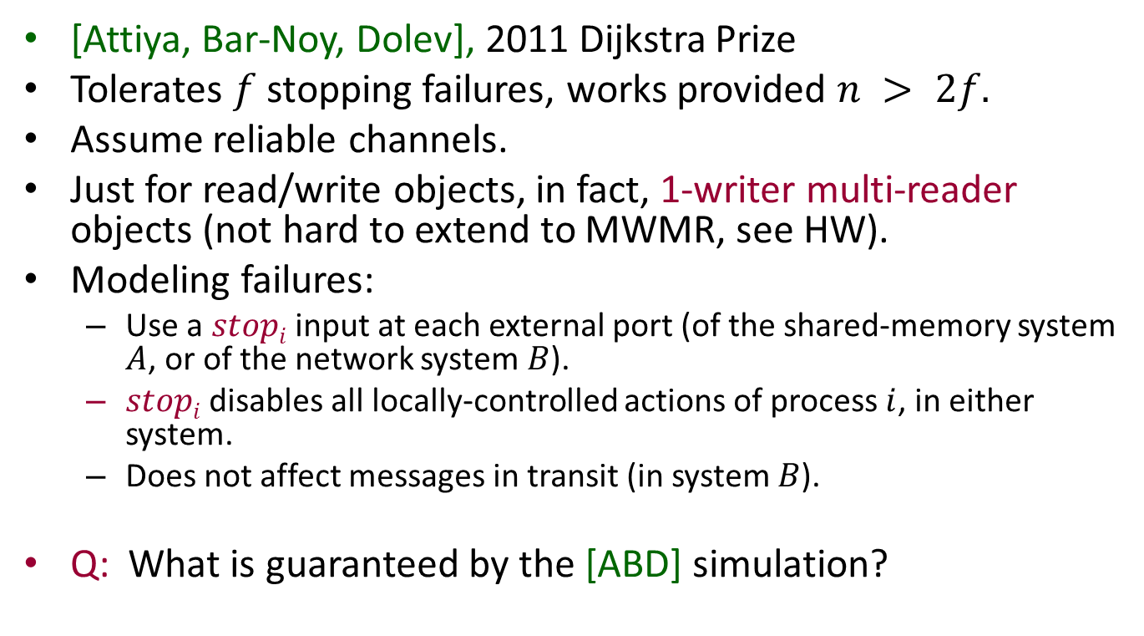
Fault-tolerant simulation of shared memory in distributed networks
[Attiya, Bar-Noy, Dolev], 2011 Dijkstra Prize
Tolerates $f$ stopping failures, works provided $n > 2f.$
Assume reliable channels.
Just for read/write objects, in fact, 1-writer multi-reader objects (not hard to extend to MWMR, see HW).
Modeling failures:
Use a $stopi$ input at each external port (of the shared-memory system $A$, or of the network system $B$).
$stopi$ disables all locally-controlled actions of process $i$, in either system.
Does not affect messages in transit (in system $B$).
Q: What is guaranteed by the [ABD] simulation?

Slide 30
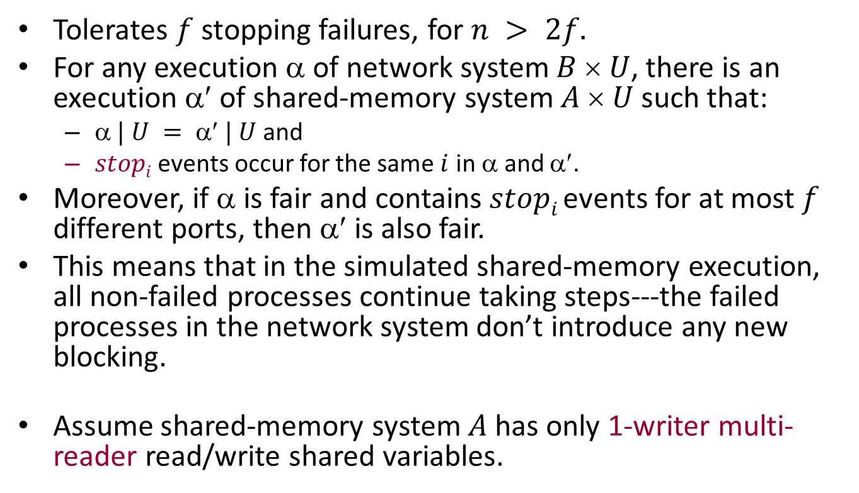
[ABD] Guarantees
Tolerates $f$stopping failures, for $n > 2f.$
For any execution $$ of network system $B  U$, there is an execution $$ of shared-memory system $A  U$such that:
$ | U =  | U$and
$stopi$ events occur for the same $i$ in $$ and $$.
Moreover, if $$ is fair and contains $stopi$ events for at most $f$ different ports, then $$is also fair.
This means that in the simulated shared-memory execution, all non-failed processes continue taking steps---the failed processes in the network system don’t introduce any new blocking.
Assume shared-memory system $A$ has only 1-writer multi-reader read/write shared variables.

Slide 31
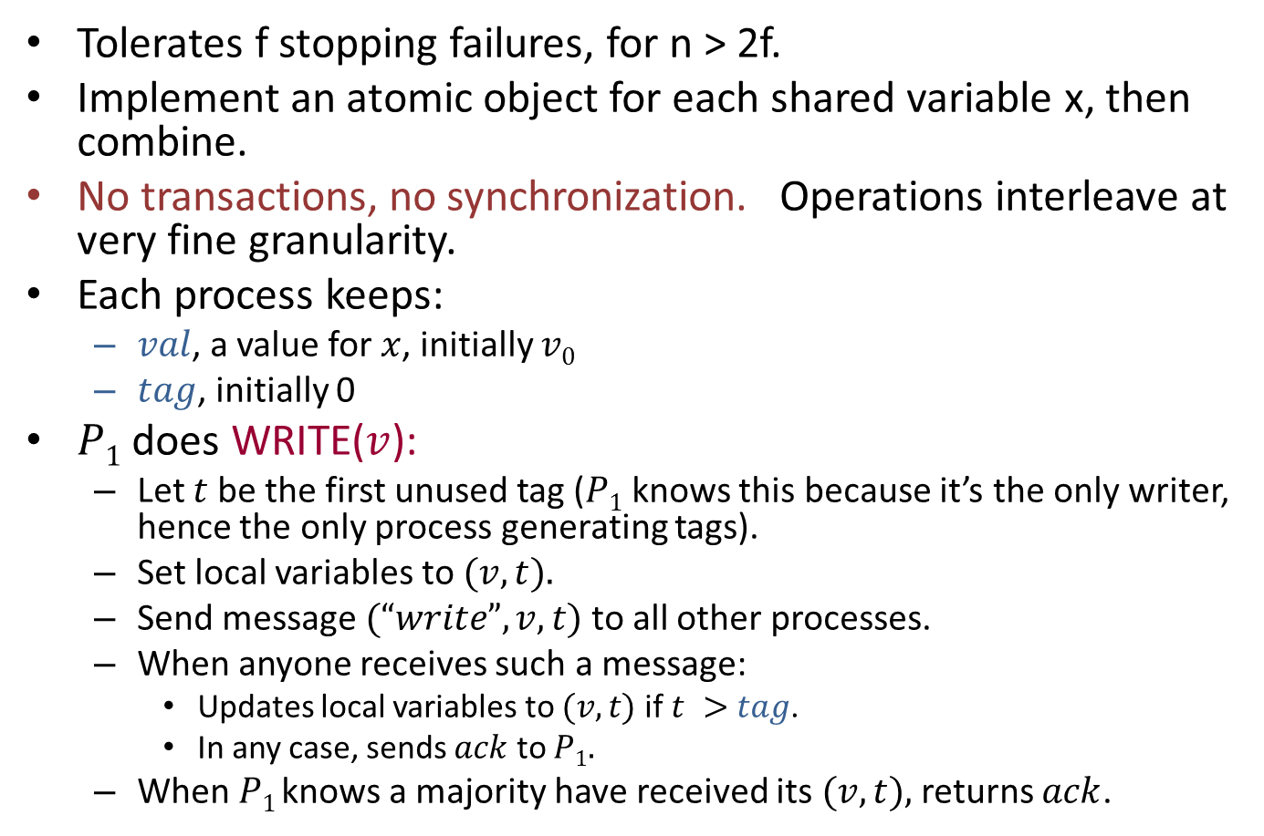
[ABD] algorithm
Tolerates f stopping failures, for n > 2f.
Implement an atomic object for each shared variable x, then combine.
No transactions, no synchronization. Operations interleave at very fine granularity.
Each process keeps:
$val$, a value for $x$, initially $v0$
$tag$, initially 0
$P1$ does WRITE($v$):
Let $t$ be the first unused tag ($P1$ knows this because it’s the only writer, hence the only process generating tags).
Set local variables to $(v,t).$
Send message $(“write”, v,t)$to all other processes.
When anyone receives such a message:
Updates local variables to $(v,t)$if $t >$ $tag$.
In any case, sends $ack$ to $P1.$
When $P1$ knows a majority have received its $(v,t),$returns $ack$.
Notes:
The other process sends the ack in any case, whether it receives new info or not.
The majority that P_1 looks for may include P_1 itself.

Slide 32
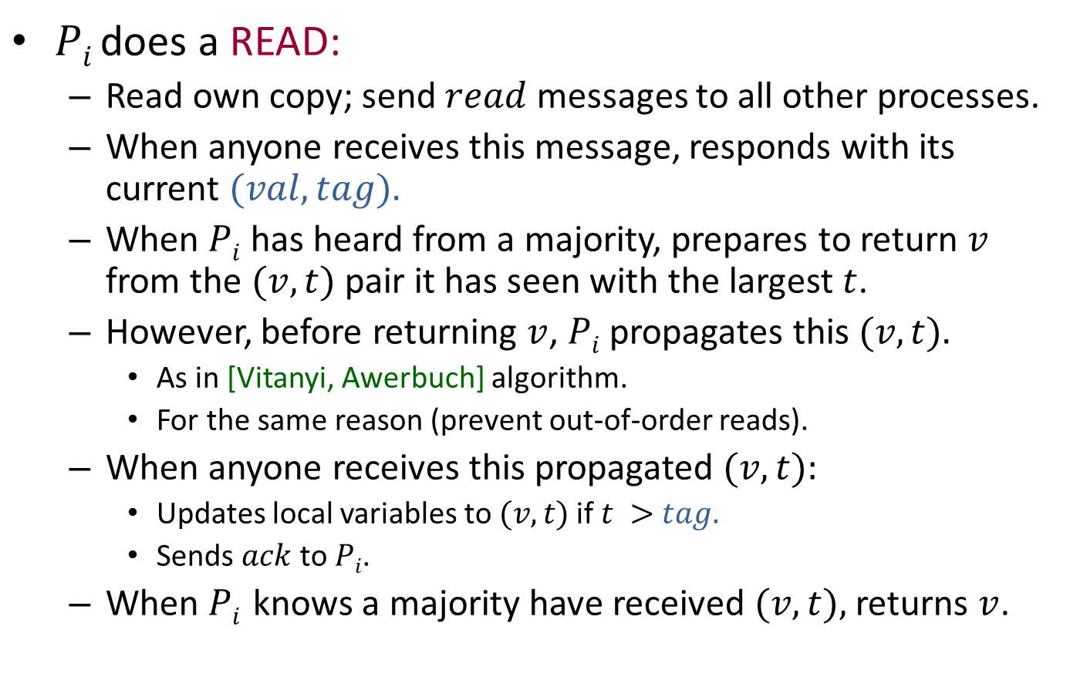
[ABD] algorithm
$Pi$does a READ:
Read own copy; send $read$ messages to all other processes.
When anyone receives this message, responds with its current $(val,tag).$
When $Pi$ has heard from a majority, prepares to return $v$ from the $(v,t)$pair it has seen with the largest $t$.
However, before returning $v$, $Pi$ propagates this $(v,t).$
As in [Vitanyi, Awerbuch] algorithm.
For the same reason (prevent out-of-order reads).
When anyone receives this propagated $(v,t):$
Updates local variables to $(v,t)$if $t >$ $tag.$
Sends $ack$ to $Pi$.
When $Pi$ knows a majority have received $(v,t),$returns $v$.

Slide 33
ABD algorithm
STATE VARIABLES
val: V, initially v₀
tag: N, initially 0
readtag: N, initially 0
lots of “bookkeeping” variables
READERS
on read
readtag := readtag+1
send “read(readtag)” to all other processes
- wait for ack from majority
let t be largest tag received
if t > tag then (val,tag) := (v,t)
where v is value received with t
send “propagate(val,tag,readtag)” to all readers
- wait for ack from majority
return val
ALL PROCESSES
on receiving “read(rt)” from _{j}
send “read-ack(val,tag,rt)” to j
READERS
on receiving “propagate(v,t)” from j
if t > tag then (val,tag) := (v,t)
send “prop-ack(t)” to j
WRITER
on write(v)
(val,tag) := (v,tag+1)
send “write(val,tag)” to all readers
- wait for ack from majority
return ack
READERS
on receiving “write(v,t)” from writer
if t > tag then
(val,tag) := (v,t)
send “write-ack(t)” to writer
Notes:
This is from Victor Luchangco. Alternatively, see my book.

Slide 34
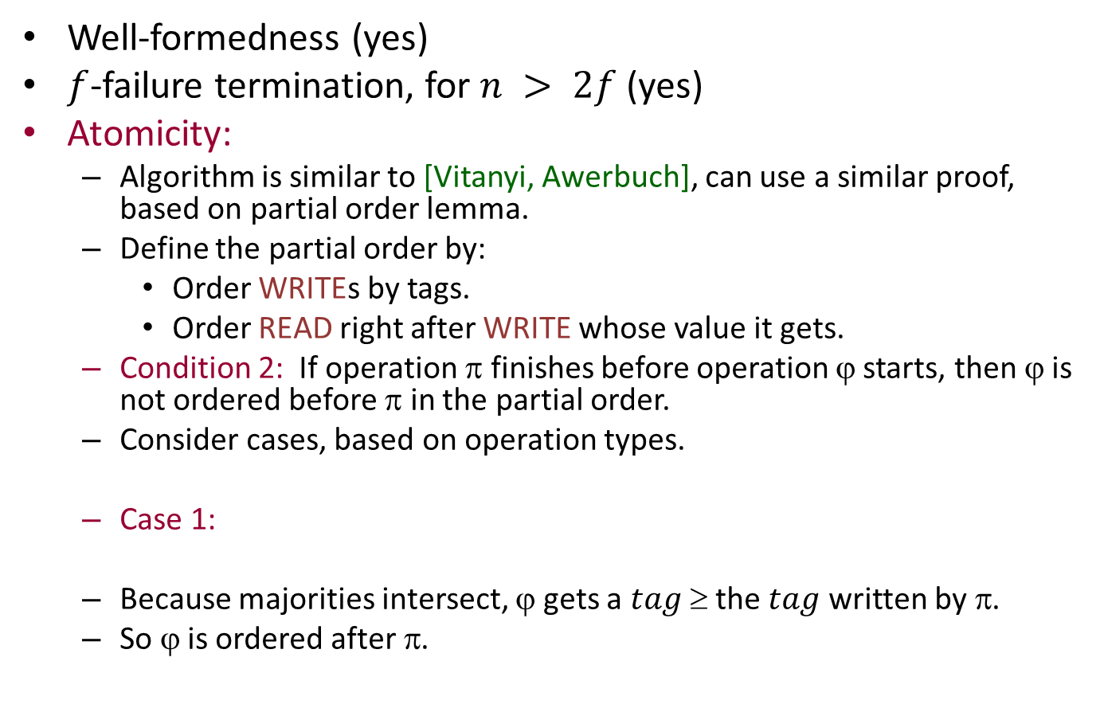
Correctness of [ABD] atomic object algorithm
Well-formedness (yes)
$f$-failure termination, for $n > 2f$(yes)
Atomicity:
Algorithm is similar to [Vitanyi, Awerbuch], can use a similar proof, based on partial order lemma.
Define the partial order by:
Order WRITEs by tags.
Order READ right after WRITE whose value it gets.
Condition 2: If operation $$ finishes before operation ϕ starts, then ϕ is not ordered before π in the partial order.
Consider cases, based on operation types.
Case 1:
Because majorities intersect, ϕ gets a $tag $ the $tag$ written by π.
So ϕ is ordered after π.
π
ϕ
WRITE
READ
Notes:
Termination follows because we wait for a (bare) majority each time.
The key condition to show is Condition 2, as usual.

Slide 35
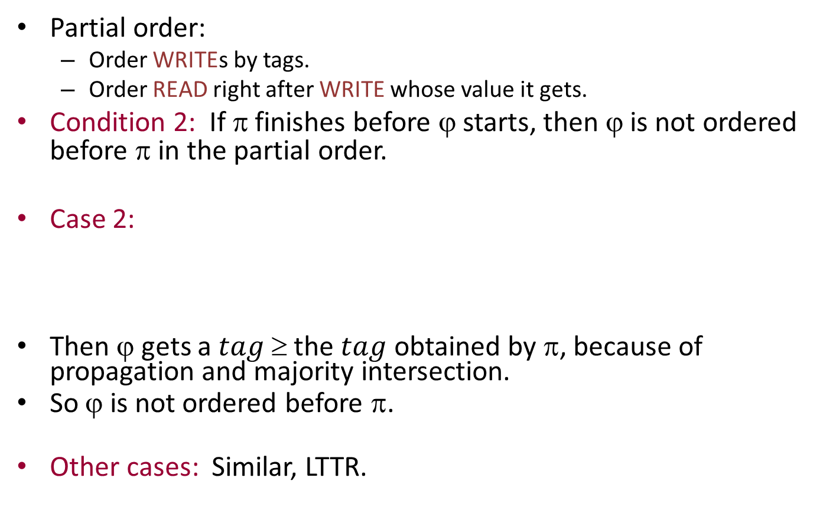
Atomicity, cont’d
Partial order:
Order WRITEs by tags.
Order READ right after WRITE whose value it gets.
Condition 2: If $$ finishes before ϕ starts, then ϕ is not ordered before π in the partial order.
Case 2:
Then ϕ gets a $tag $ the $tag$ obtained by π, because of propagation and majority intersection.
So ϕ is not ordered before π.
Other cases: Similar, LTTR.
π
ϕ
READ
READ
Notes:
Case 3: WW: Second W picks a bigger tag than previous one.
Case 4: RW: W picks a tag bigger than what the R got (bigger than anything that was there before).

Slide 36
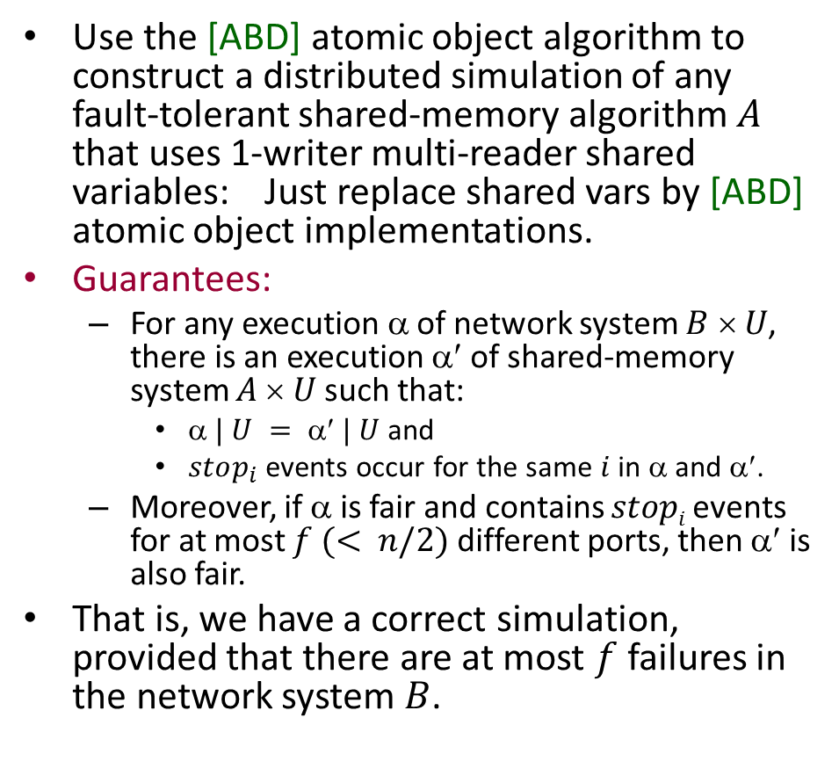
[ABD] for simulating shared memory
Use the [ABD] atomic object algorithm to construct a distributed simulation of any fault-tolerant shared-memory algorithm $A$ that uses 1-writer multi-reader shared variables: Just replace shared vars by [ABD] atomic object implementations.
Guarantees:
For any execution α of network system $B  U$, there is an execution α′ of shared-memory system $A  U$such that:
$ | U =  | U$and
$stop_{i}$events occur for the same $i$ in α and α′.
Moreover, if α is fair and contains $stopi$ events for at most $f (< n/2)$different ports, then α′ is also fair.
That is, we have a correct simulation, provided that there are at most $f$ failures in the network system $B$.
Notes:
The reason fairness is preserved is that we always have live majorities, so no variable access is ever blocked.
That means the simulation does not introduce any new blocking that wasn’t already present in the shared-memory system being simulated.

Slide 37
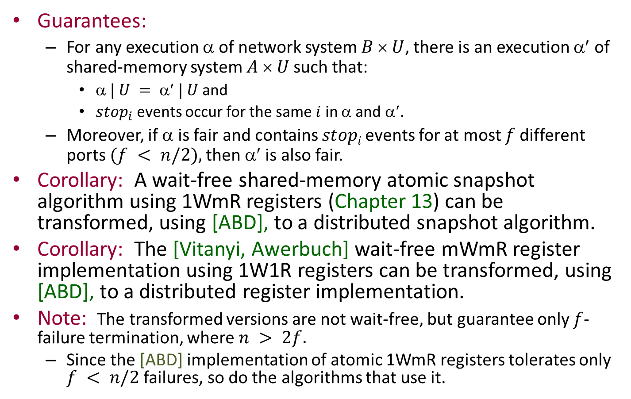
Corollaries
Guarantees:
For any execution α of network system $B  U$, there is an execution α′ of shared-memory system $A  U$such that:
$ | U =  | U$and
$stop_{i}$events occur for the same $i$ in α and α′.
Moreover, if α is fair and contains $stopi$ events for at most $f$different ports $(f < n/2),$then α′ is also fair.
Corollary: A wait-free shared-memory atomic snapshot algorithm using 1WmR registers (Chapter 13) can be transformed, using [ABD], to a distributed snapshot algorithm.
Corollary: The [Vitanyi, Awerbuch] wait-free mWmR register implementation using 1W1R registers can be transformed, using [ABD], to a distributed register implementation.
Note: The transformed versions are not wait-free, but guarantee only $f$-failure termination, where $n > 2f.$
Since the [ABD] implementation of atomic 1WmR registers tolerates only $f < n/2$ failures, so do the algorithms that use it.
Notes:
First corollary:
That is, we get a distributed network algorithm that implements a snapshot atomic object.
This is not the same as the distributed snapshots we studied earlier, for network systems.
Second corollary:
That is, we get a distributed network algorithm that implements an atomic mWmR read/write register.

Slide 38
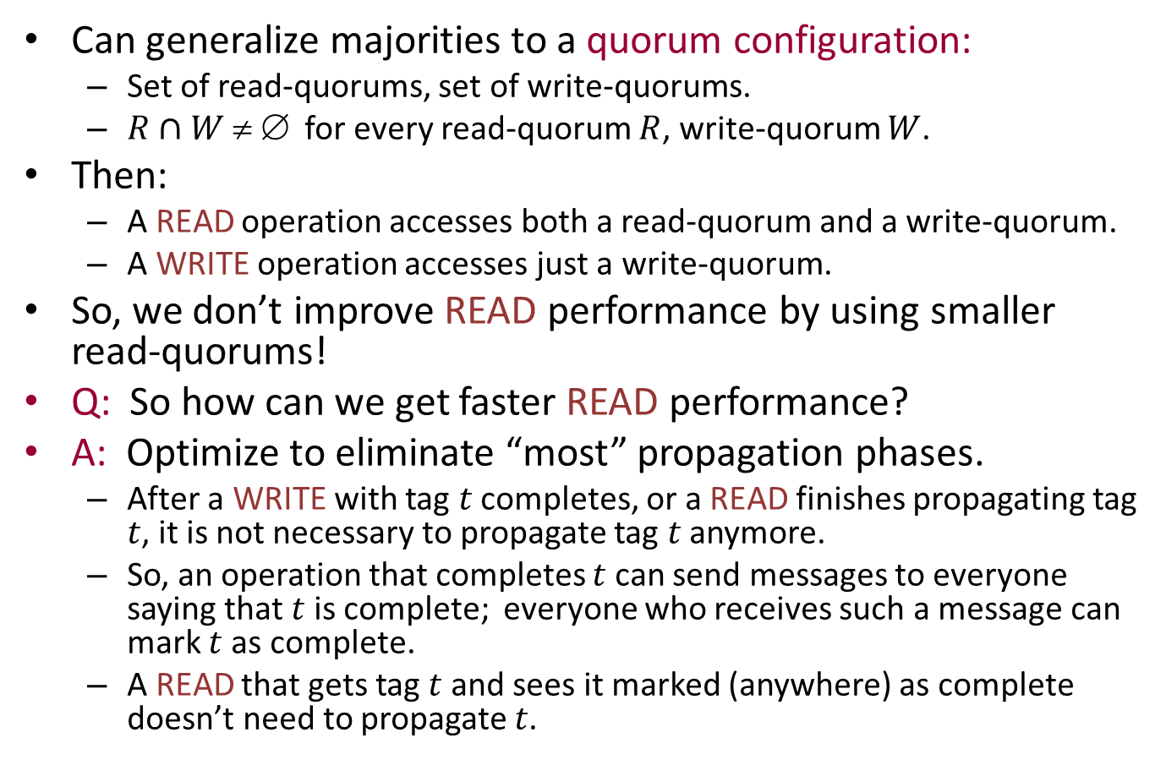
Remarks
Can generalize majorities to a quorum configuration:
Set of read-quorums, set of write-quorums.
$R∩W  $ for every read-quorum $R$, write-quorum $W$.
Then:
A READ operation accesses both a read-quorum and a write-quorum.
A WRITE operation accesses just a write-quorum.
So, we don’t improve READ performance by using smaller read-quorums!
Q: So how can we get faster READ performance?
A: Optimize to eliminate “most” propagation phases.
After a WRITE with tag $t$ completes, or a READ finishes propagating tag $t$, it is not necessary to propagate tag $t$ anymore.
So, an operation that completes $t$ can send messages to everyone saying that $t$ is complete; everyone who receives such a message can mark $t$ as complete.
A READ that gets tag $t$ and sees it marked (anywhere) as complete doesn’t need to propagate $t$.

Slide 39
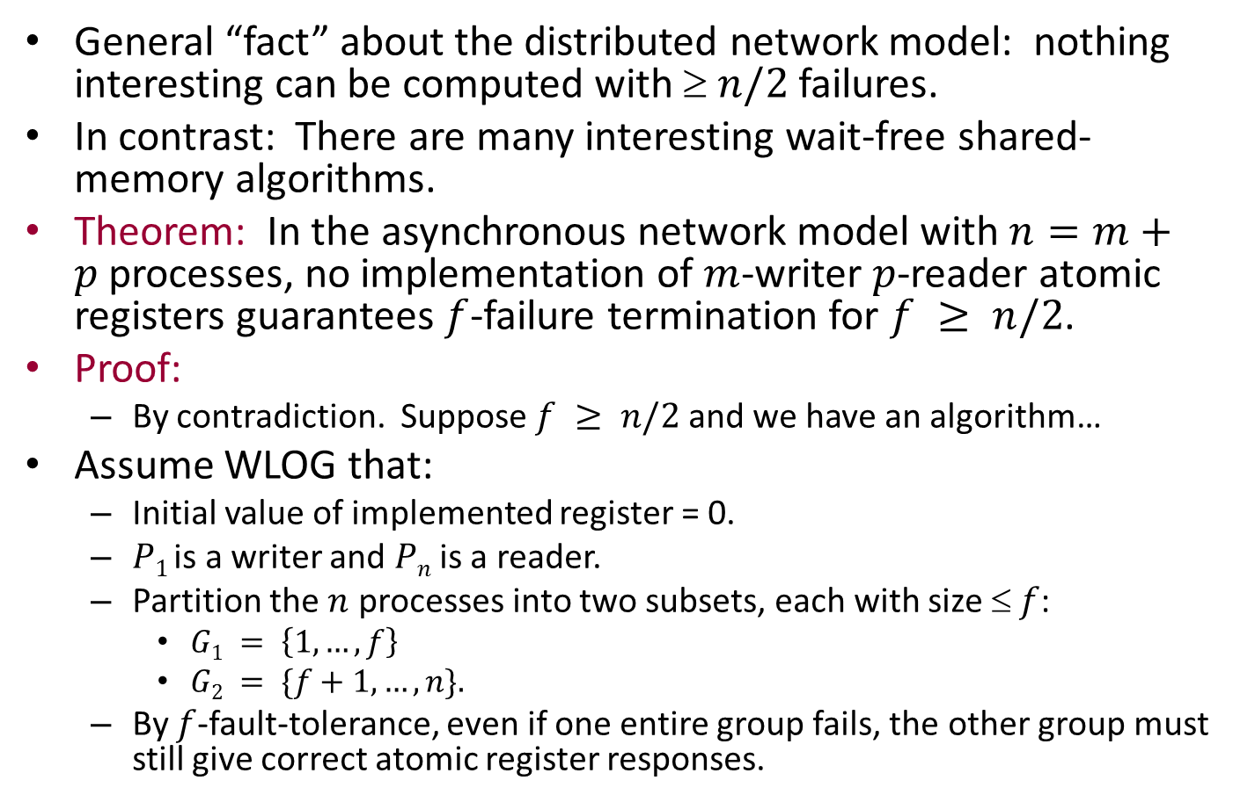
Impossibility of n/2-fault-tolerance
General “fact” about the distributed network model: nothing interesting can be computed with $ n/2$failures.
In contrast: There are many interesting wait-free shared-memory algorithms.
Theorem: In the asynchronous network model with $n=m+p$processes, no implementation of $m$-writer $p$-reader atomic registers guarantees $f$-failure termination for $f ≥ n/2$.
Proof:
By contradiction. Suppose $f ≥ n/2$and we have an algorithm…
Assume WLOG that:
Initial value of implemented register = 0.
$P1$ is a writer and $Pn$ is a reader.
Partition the $n$ processes into two subsets, each with size $ f$:
$G1 = \left\{1,…,f\right\}$
$G2 = \{f+1,…,n\}.$
By $f$-fault-tolerance, even if one entire group fails, the other group must still give correct atomic register responses.
Notes:
Result assumes m, p both geq 1.
This is similar to all the other proofs for impossibility of $n/2$-fault-tolerance.

Slide 40
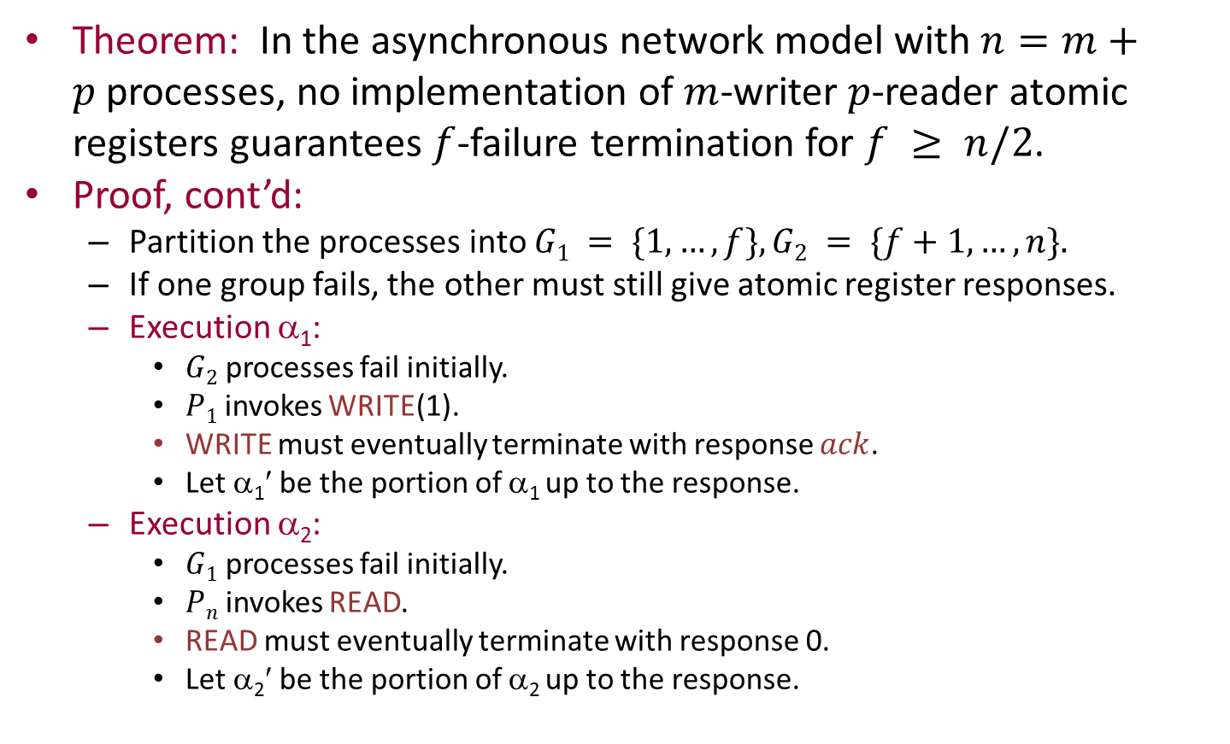
Proof, cont’d
Theorem: In the asynchronous network model with $n=m+p$processes, no implementation of $m$-writer $p$-reader atomic registers guarantees $f$-failure termination for $f ≥ n/2$.
Proof, cont’d:
Partition the processes into $G1 = \{1,…,f\}, G2 = \{f+1,…,n\}.$
If one group fails, the other must still give atomic register responses.
Execution α₁:
$G2$ processes fail initially.
$P1$ invokes WRITE(1).
WRITE must eventually terminate with response $ack$.
Let α₁′ be the portion of α₁ up to the response.
Execution α₂:
$G1$ processes fail initially.
$Pn$ invokes READ.
READ must eventually terminate with response 0.
Let α₂′ be the portion of α₂ up to the response.

Slide 41
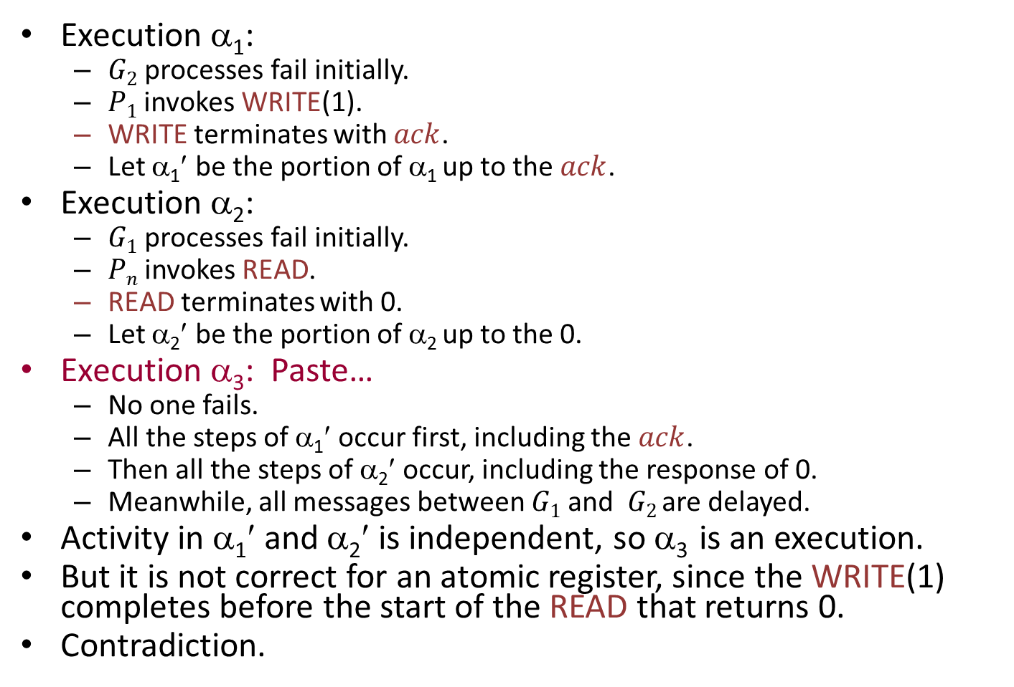
Proof, cont’d
Execution α₁:
$G2$ processes fail initially.
$P1$ invokes WRITE(1).
WRITE terminates with $ack$.
Let α₁′ be the portion of α₁ up to the $ack$.
Execution α₂:
$G1$ processes fail initially.
$Pn$ invokes READ.
READ terminates with 0.
Let α₂′ be the portion of α₂ up to the 0.
Execution α₃: Paste…
No one fails.
All the steps of α₁′ occur first, including the $ack$.
Then all the steps of α₂′ occur, including the response of 0.
Meanwhile, all messages between $G1$and $G2$are delayed.
Activity in α₁′ and α₂′ is independent, so α₃ is an execution.
But it is not correct for an atomic register, since the WRITE(1) completes before the start of the READ that returns 0.
Contradiction.
Notes:
Basically, such proofs “split the network” in two.

Slide 42
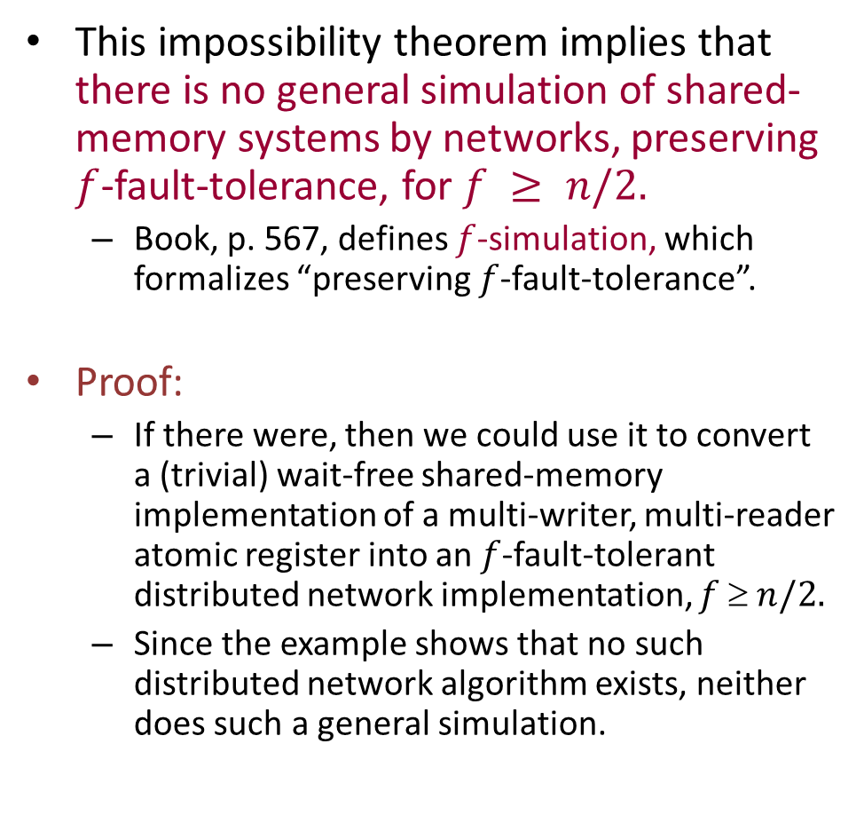
Simulating shared memory in networks
This impossibility theorem implies that there is no general simulation of shared-memory systems by networks, preserving $f$-fault-tolerance, for $f ≥ n/2.$
Book, p. 567, defines $f$-simulation, which formalizes “preserving $f$-fault-tolerance”.
Proof:
If there were, then we could use it to convert a (trivial) wait-free shared-memory implementation of a multi-writer, multi-reader atomic register into an $f$-fault-tolerant distributed network implementation, $f  n/2.$
Since the example shows that no such distributed network algorithm exists, neither does such a general simulation.
Notes:
The definition of f-simulation is similar to the overall guarantee we gave earlier for [ABD].
The trivial implementation: Just one shared R/W variable.

Slide 43
Remarks
[ABD] can be extended to dynamically-changing networks:
RAMBO (Reconfigurable Atomic Memory for Basic Objects) algorithm [Gilbert, Lynch, Shvartsman] works in dynamic networks.
Supports reconfiguration, in addition to reads and writes.
Q: All the algorithms we have considered emulate shared read/write registers only. What about other data types?
The situation is very different, because some objects are much more powerful than registers, e.g., CAS objects have the “power of consensus”.
ABD doesn’t work.
Now consider emulating more powerful data objects.
Start with simpler problem: Consensus in fault-prone networks.
We have inherent limitations [FLP], so we must weaken requirements.
[Dwork, Lynch, Stockmeyer], failure-detector approaches, Paxos
Notes:
We will only revisit RAMBO later, very briefly.
The consensus problem is simpler because it’s one-shot. Emulating shared memory involves some sort of repeated consensus.

Slide 44

Fault-Tolerant Agreement in Asynchronous Networks: The Paxos Algorithm

Slide 45
Fault-tolerant agreement in asynchronous networks
It’s impossible to reach agreement in asynchronous networks, even if we assume that at most one failure will occur.
What if we really need to?
For transaction commit.
For agreeing on the order in which to perform operations on an emulated shared data object.
…
Some possible approaches:
Randomized algorithm [Ben-Or], terminates with high probability.
Approximate agreement.
Use a failure detector service, implemented by timeouts (next time).

Slide 46
A nice approach: Eventual stability
Guarantee agreement, validity in all cases.
Guarantee termination if the system eventually “stabilizes”:
No more failures, recoveries, message losses.
Timing of messages, process steps within “normal” bounds.
Termination should be fast after system stabilizes.
Actually, stable behavior need not continue forever, just long enough for computation to terminate.
This general approach (safety is absolute, liveness depends on stabilization of the behavior of the underlying system) is regarded as the best approach to building practical fault-tolerant distributed data-management systems [Microsoft] [Google] [HP]…
Notes:
This is the approach that has come to dominate for building real fault-tolerant distributed data systems.

Slide 47
Eventual stability: Some history
[Dwork, Lynch, Stockmeyer] first presented a consensus algorithm with these properties.
[Cristian] used a similar approach for group membership algorithms.
[Lamport, Part-Time Parliament]
Introduced the Paxos algorithm.
Relationship with [DLS]:
Achieves similar guarantees.
Paxos allows more concurrency, tolerates some more kinds of failures.
Basic strategy for assuring safety similar to [DLS].
Paxos has been used as a subroutine in an algorithm to emulate powerful shared memory, which has been engineered for practical use.
Background:
Paper unpublished for 10 years because of nonstandard style. (Read it!)
Eventually published “as is”, because others were recognizing its importance and building on its ideas.

Slide 48
Paxos consensus protocol
Called Single-Decree Synod protocol.
Assumptions:
Asynchronous processes, stopping failures, also recovery.
Messages may be lost.
Lamport’s paper also describes how to cope with disk crashes, where volatile memory is lost (we’ll skip this).
We’ll present the algorithm in two stages:
Describe a very nondeterministic algorithm that guarantees the safety properties (agreement, validity).
Constrain it to get termination soon after stabilization.

Slide 49
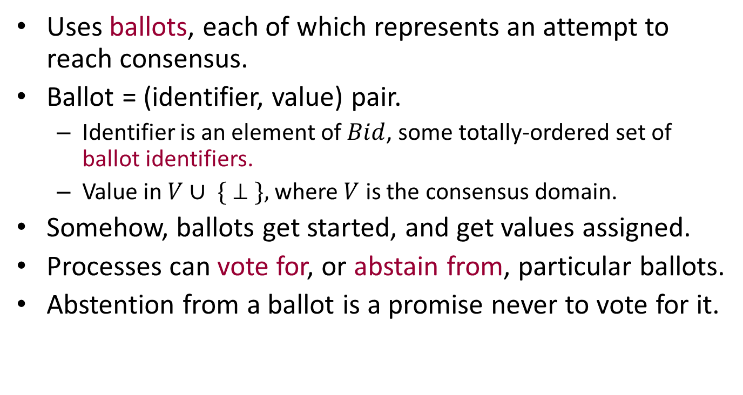
The “safe” algorithm: Ballots
Uses ballots, each of which represents an attempt to reach consensus.
Ballot = (identifier, value) pair.
Identifier is an element of $Bid$, some totally-ordered set of ballot identifiers.
Value in $V∪ \{ ⊥ \},$where $V$ is the consensus domain.
Somehow, ballots get started, and get values assigned.
Processes can vote for, or abstain from, particular ballots.
Abstention from a ballot is a promise never to vote for it.

Slide 50
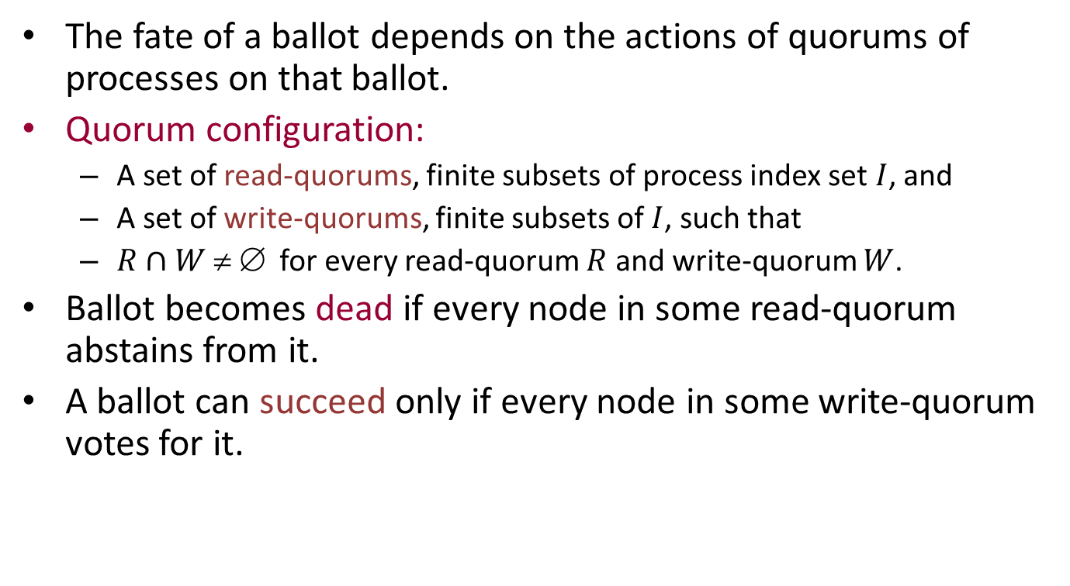
Quorums
The fate of a ballot depends on the actions of quorums of processes on that ballot.
Quorum configuration:
A set of read-quorums, finite subsets of process index set $I$, and
A set of write-quorums, finite subsets of $I$, such that
$R∩W  $ for every read-quorum $R$ and write-quorum $W$.
Ballot becomes dead if every node in some read-quorum abstains from it.
A ballot can succeed only if every node in some write-quorum votes for it.
Notes:
Generalizes majorities.
Could use quorums in ABD, for example (I think I already mentioned this).

Slide 51
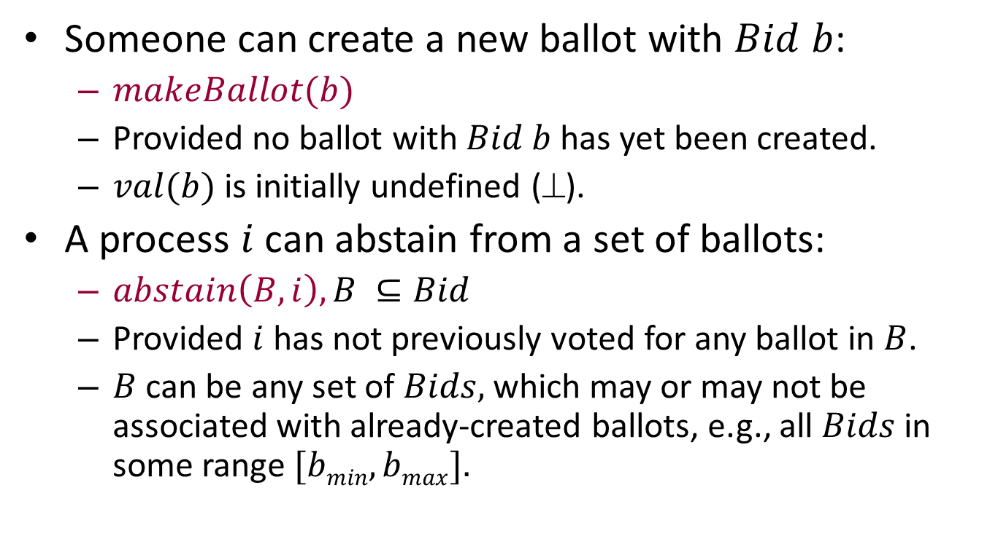
Safe algorithm, centralized version
Someone can create a new ballot with $Bid b$:
$makeBallot(b)$
Provided no ballot with $Bid b$ has yet been created.
$val(b)$ is initially undefined (⊥).
A process $i$ can abstain from a set of ballots:
$abstain\left(B,i\right), B ⊆Bid$
Provided $i$ has not previously voted for any ballot in $B$.
$B$ can be any set of $Bids,$ which may or may not be associated with already-created ballots, e.g., all $Bids$ in some range $[bmin, bmax].$
Notes:
The fact that B can be any set of Bids turns out to be important.

Slide 52
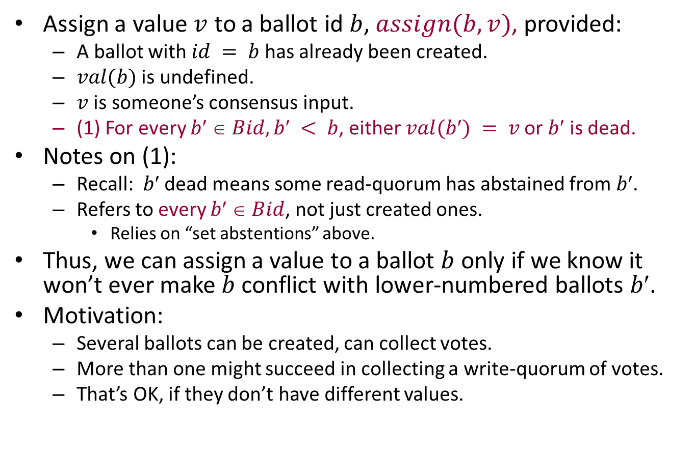
Safe algorithm, centralized version
Assign a value $v$ to a ballot id $b$, $assign(b,v)$, provided:
A ballot with $id = b$has already been created.
$val(b)$ is undefined.
$v$ is someone’s consensus input.
(1) For every $b  Bid, b < b$, either $val(b) = v$or $b$ is dead.
Notes on (1):
Recall: $b$ dead means some read-quorum has abstained from $b$.
Refers to every $b  Bid$, not just created ones.
Relies on “set abstentions” above.
Thus, we can assign a value to a ballot $b$ only if we know it won’t ever make $b$ conflict with lower-numbered ballots $b$.
Motivation:
Several ballots can be created, can collect votes.
More than one might succeed in collecting a write-quorum of votes.
That’s OK, if they don’t have different values.
Notes:
If b′ is dead, it can’t conflict.

Slide 53
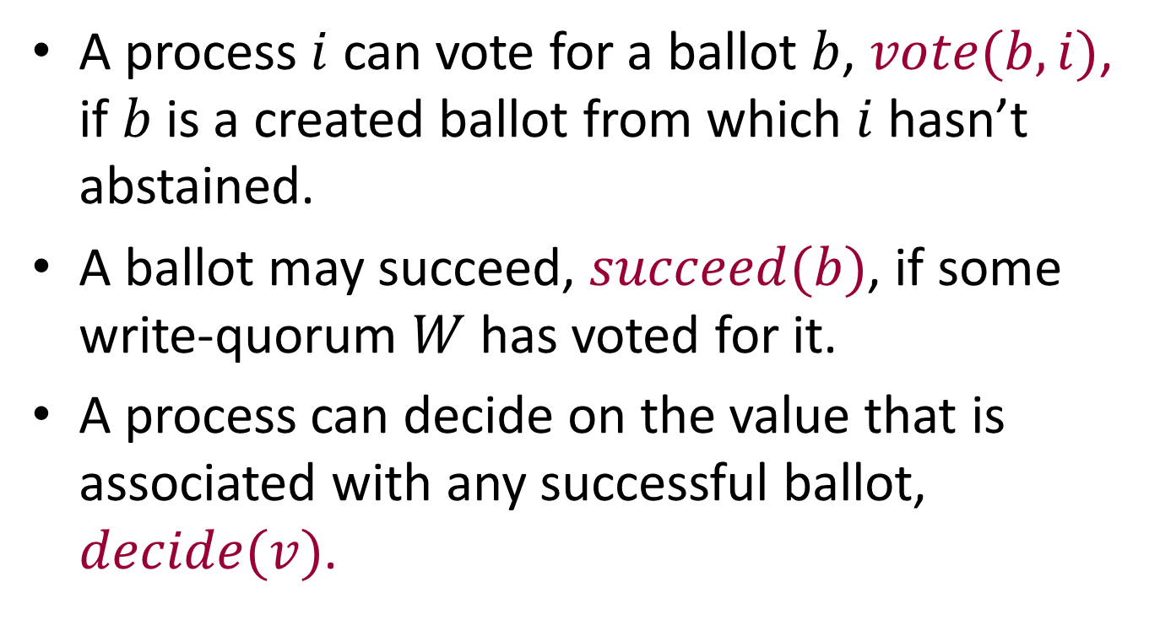
Safe algorithm, centralized version
A process $i$ can vote for a ballot $b$, $vote(b,i)$, if $b$ is a created ballot from which $i$ hasn’t abstained.
A ballot may succeed, $succeed(b)$, if some write-quorum $W$ has voted for it.
A process can decide on the value that is associated with any successful ballot, $decide(v)$.

Slide 54
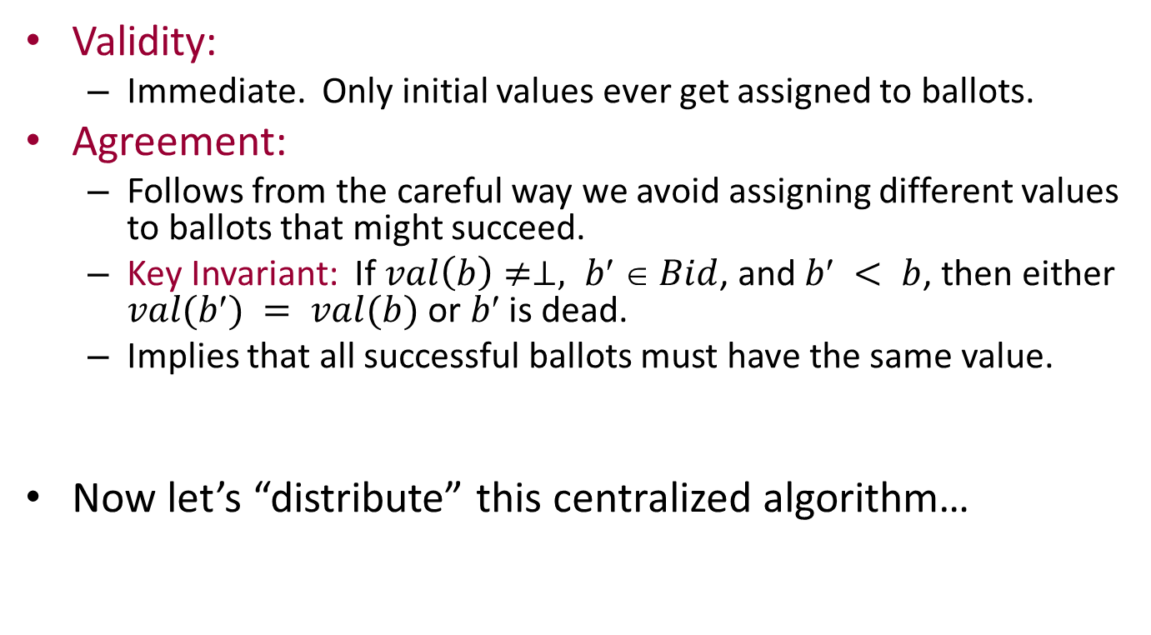
Safety properties
Validity:
Immediate. Only initial values ever get assigned to ballots.
Agreement:
Follows from the careful way we avoid assigning different values to ballots that might succeed.
Key Invariant: If $val\left(b\right)≠⊥, b′ ∈ Bid$, and $b < b$, then either $val(b) = val(b)$or $b$ is dead.
Implies that all successful ballots must have the same value.
Now let’s “distribute” this centralized algorithm…

Slide 55
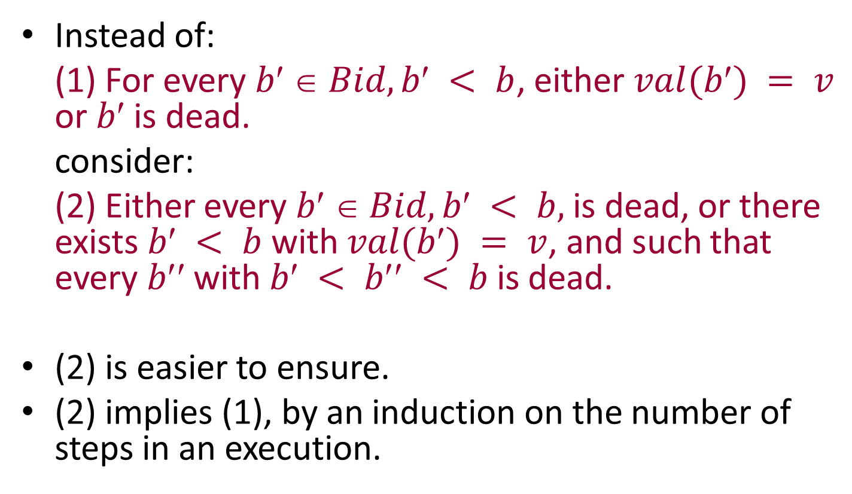
Modifying Condition (1) for assigning ballot values
Instead of:
(1) For every $b  Bid, b < b$, either $val(b) = v$ or $b$ is dead.
consider:
(2) Either every $b  Bid, b < b,$is dead, or there exists $b < b$with $val(b) = v$, and such that every $b$with $b < b < b$is dead.
(2) is easier to ensure.
(2) implies (1), by an induction on the number of steps in an execution.

Slide 56
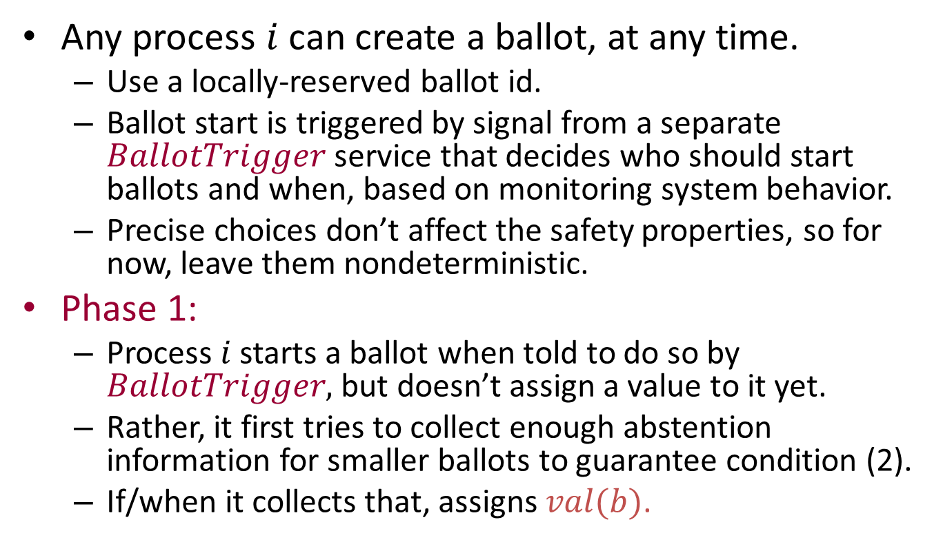
Safe algorithm, distributed version
Any process $i$ can create a ballot, at any time.
Use a locally-reserved ballot id.
Ballot start is triggered by signal from a separate $BallotTrigger$ service that decides who should start ballots and when, based on monitoring system behavior.
Precise choices don’t affect the safety properties, so for now, leave them nondeterministic.
Phase 1:
Process $i$ starts a ballot when told to do so by $BallotTrigger,$ but doesn’t assign a value to it yet.
Rather, it first tries to collect enough abstention information for smaller ballots to guarantee condition (2).
If/when it collects that, assigns $val(b)$.
Notes:
This is still highly nondeterministic. Can create ballots at any time, etc.

Slide 57
Safe algorithm, distributed version
Phase 2:
Tries to get enough other processes to vote for its new ballot.
Communication pattern:
make-ballot
Phase 1, collect abstention information
assign-val
Phase 2, collect votes
succeed

Slide 58
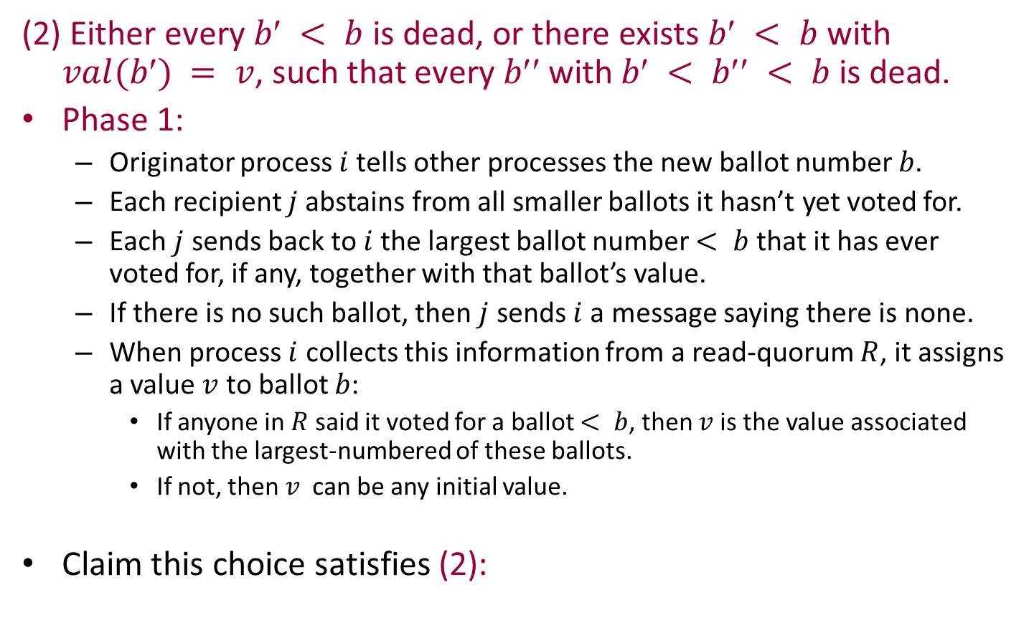
Ensuring Condition (2)
(2) Either every $b < b$is dead, or there exists $b < b$with $val(b) = v$, such that every $b$with $b < b < b$is dead.
Phase 1:
Originator process $i$tells other processes the new ballot number $b$.
Each recipient $j$abstains from all smaller ballots it hasn’t yet voted for.
Each $j$ sends back to $i$the largest ballot number $< b$ that it has ever voted for, if any, together with that ballot’s value.
If there is no such ballot, then $j$ sends $i$a message saying there is none.
When process $i$ collects this information from a read-quorum $R$, it assigns a value $v$ to ballot $b$:
If anyone in $R$ said it voted for a ballot $< b$, then $v$is the value associated with the largest-numbered of these ballots.
If not, then $v$ can be any initial value.
Claim this choice satisfies (2):
Notes:
This is expanding the details of what happens in Phase 1, in terms of distributed processing.

Slide 59
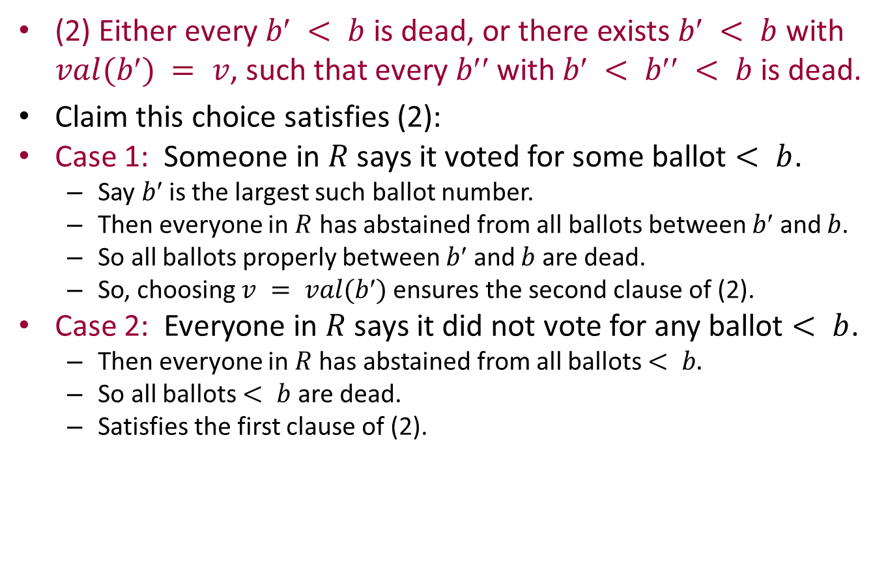
Ensuring Condition (2)
(2) Either every $b < b$is dead, or there exists $b < b$with $val(b) = v$, such that every $b$with $b < b < b$is dead.
Claim this choice satisfies (2):
Case 1: Someone in $R$ says it voted for some ballot $< b$.
Say $b$is the largest such ballot number.
Then everyone in $R$ has abstained from all ballots between $b$ and $b$.
So all ballots properly between $b$ and $b$ are dead.
So, choosing $v = val(b)$ensures the second clause of (2).
Case 2: Everyone in $R$ says it did not vote for any ballot $< b$.
Then everyone in $R$has abstained from all ballots $< b.$
So all ballots $< b$ are dead.
Satisfies the first clause of (2).

Slide 60
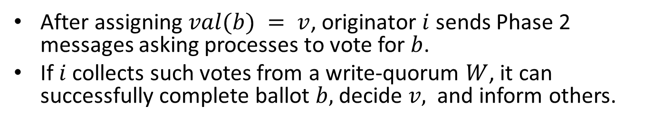
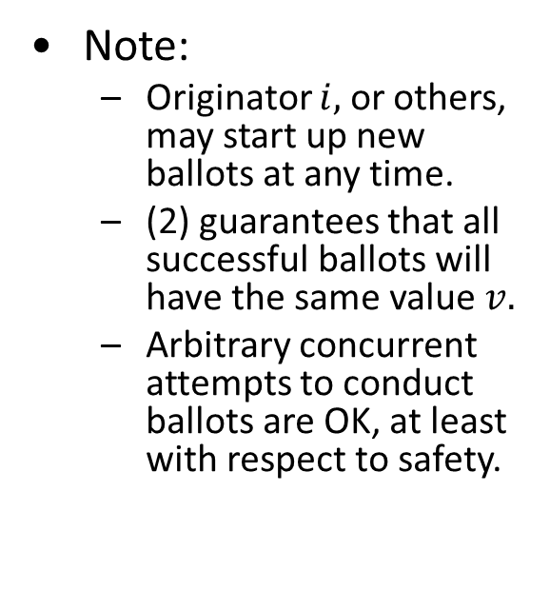
Safe algorithm, distributed version, cont’d
After assigning $val(b) = v$, originator $i$ sends Phase 2 messages asking processes to vote for $b$.
If $i$ collects such votes from a write-quorum $W$, it can successfully complete ballot $b,$decide $v,$and inform others.
Note:
Originator $i,$ or others, may start up new ballots at any time.
(2) guarantees that all successful ballots will have the same value $v.$
Arbitrary concurrent attempts to conduct ballots are OK, at least with respect to safety.
make-ballot
Phase 1,
collect abstentions
assign-val
Phase 2,
collect votes
succeed
Notes:
Once the originator of the ballot decides, it can inform the others of the decision.

Slide 61
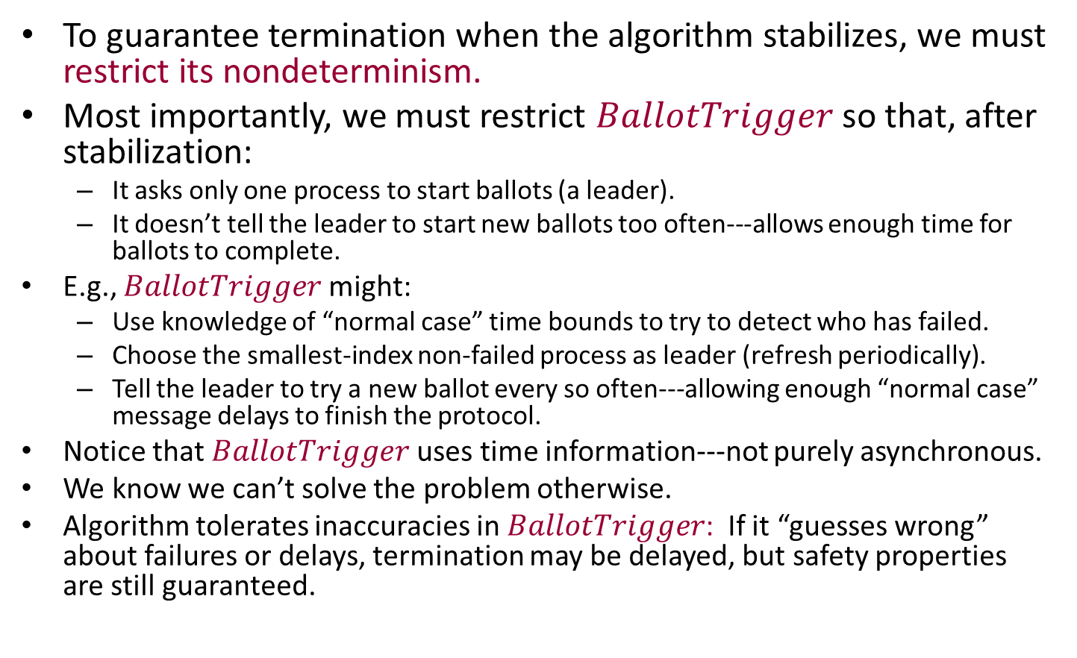
Live version of the algorithm
To guarantee termination when the algorithm stabilizes, we must restrict its nondeterminism.
Most importantly, we must restrict $BallotTrigger$ so that, after stabilization:
It asks only one process to start ballots (a leader).
It doesn’t tell the leader to start new ballots too often---allows enough time for ballots to complete.
E.g., $BallotTrigger$might:
Use knowledge of “normal case” time bounds to try to detect who has failed.
Choose the smallest-index non-failed process as leader (refresh periodically).
Tell the leader to try a new ballot every so often---allowing enough “normal case” message delays to finish the protocol.
Notice that $BallotTrigger$uses time information---not purely asynchronous.
We know we can’t solve the problem otherwise.
Algorithm tolerates inaccuracies in $BallotTrigger$: If it “guesses wrong” about failures or delays, termination may be delayed, but safety properties are still guaranteed.
Notes:
There are other things to do to guarantee liveness.
For example, we should specify that processes don’t abstain for no reason, but only when they already know of a larger-numbered ballot.
And we should insist that all processes actually respond to all phase 1 and phase 2 messages.
The coordinator shouldn’t abandon a ballot unless it hears that someone has abstained from it.
----------
And we should have the originator of a ballot inform the others when it reaches a decision.
This is guaranteed to terminate if the system is “stable” for long enough: no failures and recoveries, and timing within normal bounds.

Slide 62
Using Paxos to emulate general shared memory in a network
Paxos paper suggests using the Paxos consensus algorithm repeatedly, to agree on successive operations on a shared data object.
Idea is similar to Herlihy’s universal construction.
Uses Replicated State Machines (RSM).
Emulates shared atomic objects that tolerate stopping failures and recoveries, message loss and duplication.
Paper also includes various optimizations, LTTR.
Considerable follow-on work, engineering Paxos to work for maintaining real data efficiently.
Disk Paxos
HP, Microsoft, Google,…

Slide 63
Next time
Failure detectors
Readings:
[Chandra, Toueg] Unreliable FDs for reliable distributed systems
[Cornejo, Lynch, Sastry] Asynchronous FDs
[Pike, Song, Sastry] FDs for Dining Philosophers
[Sastry, Pike, Welch] Weakest FD for Wait-Free Dining Philosophers
[Chandra, Hadzilacos, Toueg] Weakest FD for Consensus
[Lynch, Sastry] Weakest Asynchronous FD for Consensus

